Slide 1
Urban Areas
Sofia Venturoli
A.A. 2020/21
Latin American Anthropology

Slide 2
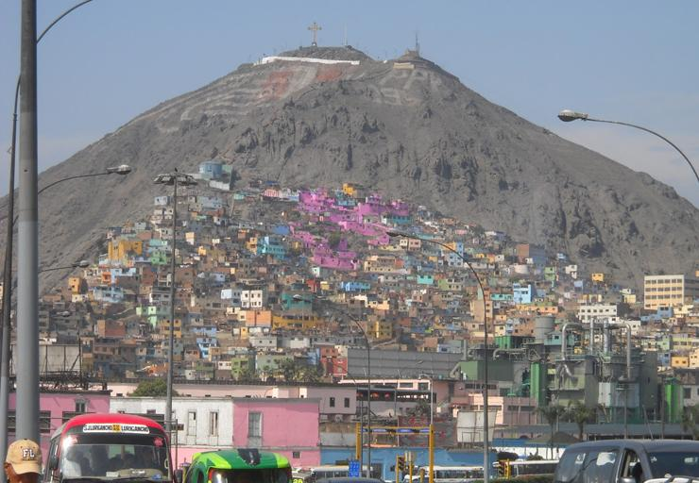
Lima la horible
Latin American Anthropology
Sofia Venturoli

Slide 3
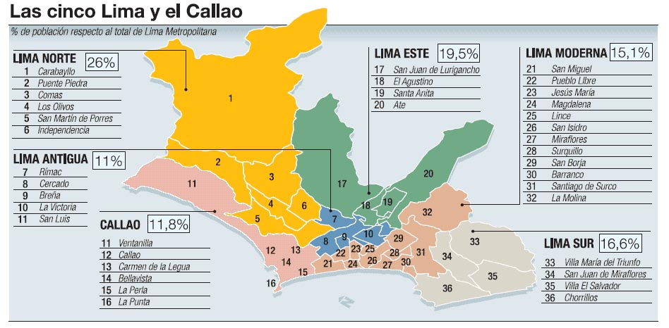
Latin American Anthropology
Sofia Venturoli

Slide 4
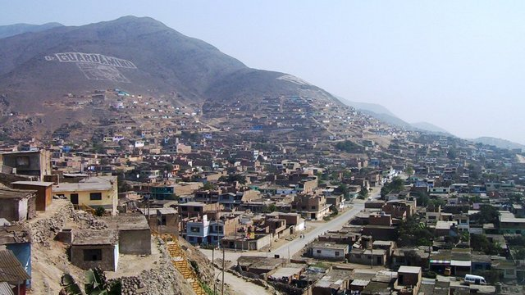
El Progreso, Carabayllo
Latin American Anthropology
Sofia Venturoli

Slide 5
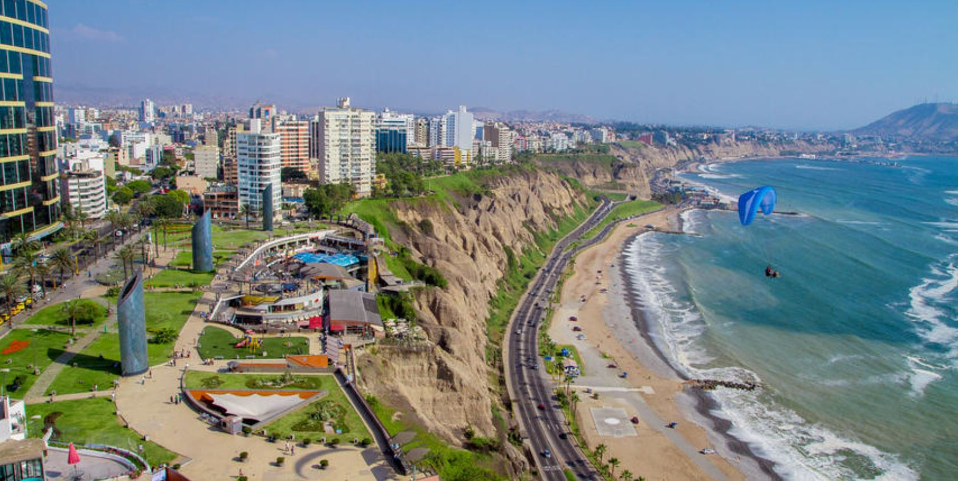
Miraflores
Latin American Anthropology
Sofia Venturoli

Slide 6
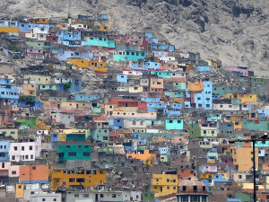
migration and urban-adaptation
The reconstruction of the migratory process from the city, trying to understand the reasons and the adaptation strategies, as long as the categories and the Andean organization are modified.
Importance of the origin community cohesion, solidarity.
The polarity between field and city: field as traditional, city as modernity
Latin American Anthropology
Sofia Venturoli

Slide 7
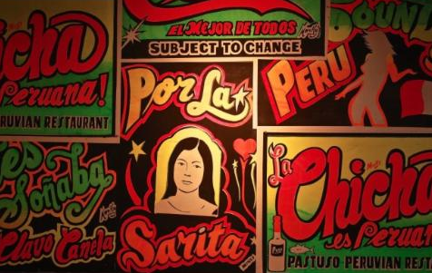
Adjustment to the city
Language
Music
Regional association: acculturative and the integrative
Cultural creativity
Latin American Anthropology
Sofia Venturoli

Slide 8
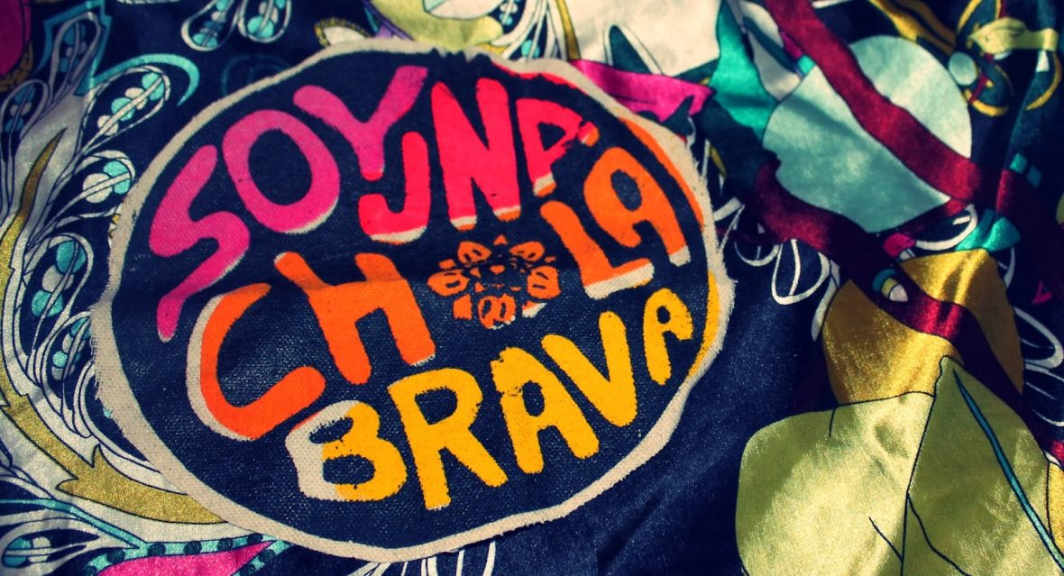
Barriadas
Pueblos jovenes
Refutation of Lewis's theory of the culture of poverty attributed to slum dwellers
Barriadas and pueblos jovenes as producers of new cultural and social perspectives, articulation of resistance practices and social mobility
Production of space
Latin American Anthropology
Sofia Venturoli

Slide 9
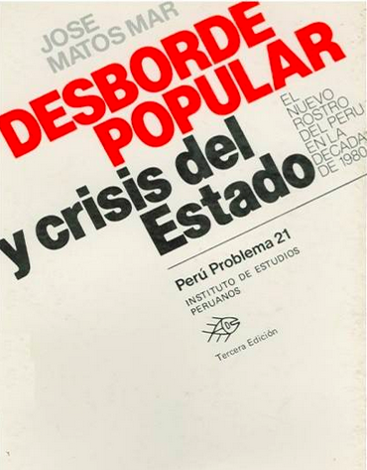
Desborde Popular y crisis del Estado, Matos Mar (1984)
Migration and modernity
Lo andino and lo criollo
The optimistic vision
More global, more relational identities in a vision that includes realities that go beyond the specific group
The cholo culture
Latin American Anthropology
Sofia Venturoli

Slide 10
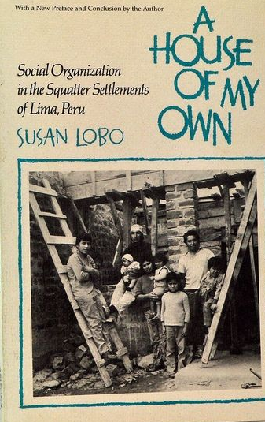
A House of my own, Susan Lobo,(1982)
Ciudadela Chalaca e Dulanto
Relationship
Family networks
Marriage alliances
Community ties
Compadrazgo
Ethnic stratification:
criollos, cholos, zambos
Racial dynamics
Latin American Anthropology
Sofia Venturoli

Slide 11
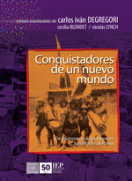
Conquistadores de un nuevo mundo. De invasores a ciudadanos…
Degregori, Blondet, Lynch (1986)
Clases populares e urbanizacion en el Perù - IEP
The stories of invasions from the 40s to the 80s
The relationship between culture and class
The presence of individual actors in relation with the collectivity
Citizenship demanding
New forms of politics
New forms of association
Marxist vision in which ethnic identities are diluted and class identities are reaffirmed
Latin American Anthropology
Sofia Venturoli

Slide 12
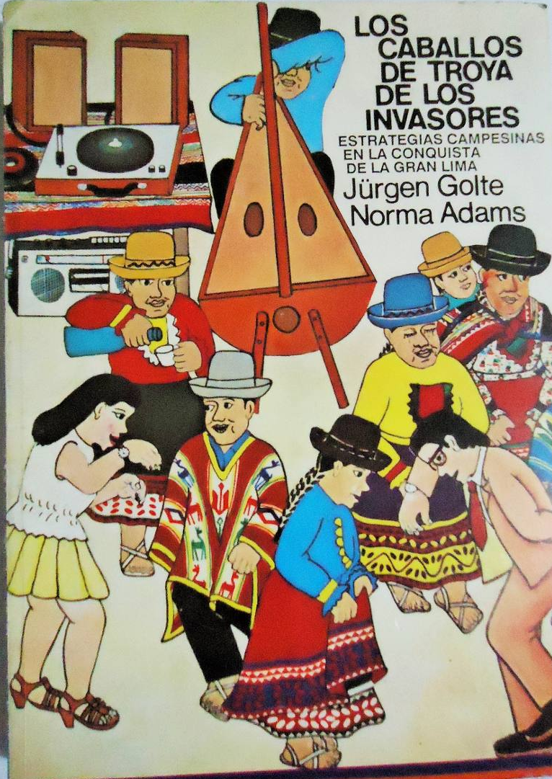
Los caballos de Troya de los invasores. Estrategias campesinas en la conquista de la gran Lima.
Golte, Adams (1986)
The different insertion strategies based on the community of origin.
The relationships between rural and urban areas
The study of changes put in places by migrants
Latin American Anthropology
Sofia Venturoli

Slide 13
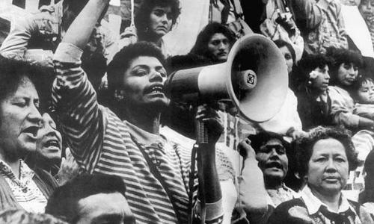
Gender Studies
Mucha vida construyendo identidad. Mujeres pobladoras de un barrio limeno. Cecilia Blondet 1987
Studies on Villa el Salvador
the comedores populares, clubes de madres, and the consequences of the internal war
Latin American Anthropology
Sofia Venturoli

Slide 14
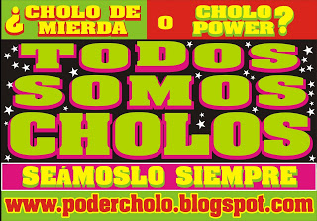
90s-2000
Urban generation, pluriarticulated spaces
New technologies
Transnational migrations
From *cholificación to cholo power
Cultural creativity, interaction among different actors
*Dominacion y Cultura. Lo cholo y el conflicto cultural en el Perù. Anibal Quijano (1980)
Latin American Anthropology
Sofia Venturoli

Slide 15
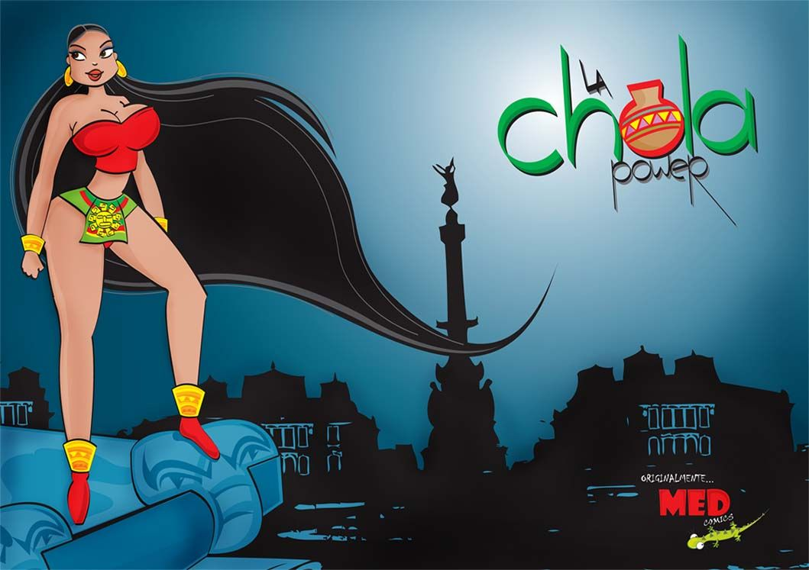
Cholo is pop
Latin American Anthropology
Sofia Venturoli

