Slide 1
Border thought
Sofia Venturoli
A.A. 2020/21
Latin American Anthropology

Slide 2
Nome del corso
“In order to have History you must be colonized” (Mignolo 2005)
Modernity doesn't exist without colonization: one history prevails over the others
Evangelization as the language of salvation
America as a European construction
Ideological construction of racism as a fundamental new categorization of humanity to build the basis of the new hierarchical order
Latin American Anthropology
Sofia Venturoli

Slide 3
Nome del corso
Columbus discovers America but
not the Americans
Communication and lack of understanding
The doctrine of inequality: superiority and assimilation, proximity to the model of the human ideal
Alterity (otherness) is at the same time revealed and refused
American alterity is perceived through projection of preexisting cultural categories: assimilation or difference.
Anomie (social instability): dismantling and violence without redress
Latin American Anthropology
Sofia Venturoli

Slide 4
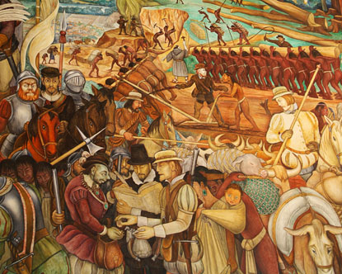
The polemica de los naturales: the dispute about the humanity of the indios
The Junta de Valladolid 1550; 1551
Bartolomé de Las Casas: equality and assimilation
Juan Gines de Sepulveda: hierarchy as a natural state of human society
Latin American Anthropology
Sofia Venturoli

Slide 5
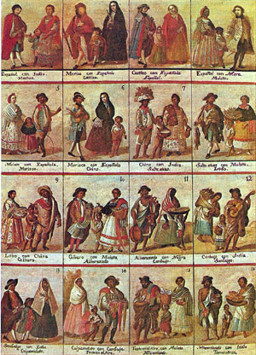
Taxonomic anxiety
1. Mestizo hijo de español e india
2. Castizo hijo de español y mestiza
3. Español hijo de castizo y española
4. Mulato hijo de español y negra.
5. Morisco hijo de mulata y español.
6. Albino hijo de español y morisca.
7. Salta para atrás hijo de español y albina
8. Lobo hijo de indio y negra
9. Coyote hijo de indio y mestiza
10. Chino hijo de lobo y negra.
11.Cambujo hijo de chino e india
12. Detente en el aire hijo de cambujo e india
13. No te entiendo hijo de detente en el aire con mulata.
14. Barcino hijo de no te entiendo e india
15. Calpamulato hijo de barcino y cambuja.
Notes:
5

Slide 6
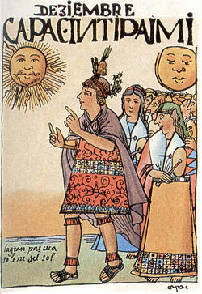
Evangelization
is the supreme good and the only justification for the conquest

Slide 7
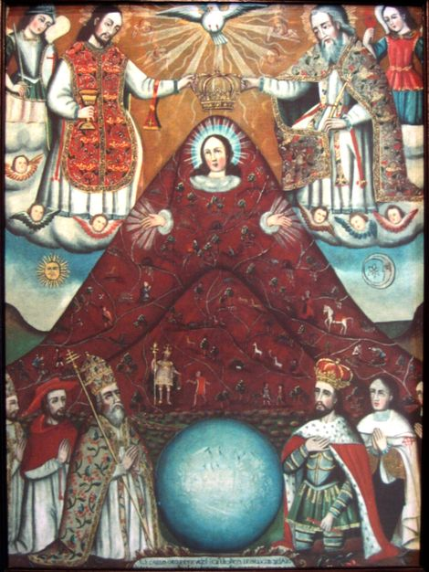
The Church as a “Westernizing” actor
Among the lower classes the mestiza religion, with its periodic rites, the proliferation of the cults of Saints and various manifestations of the Virgin Mary, and with its innumerable organizations and fraternities, becomes a vehicle of social inclusion and integration among different races.
Latin American Anthropology
Sofia Venturoli

Slide 8
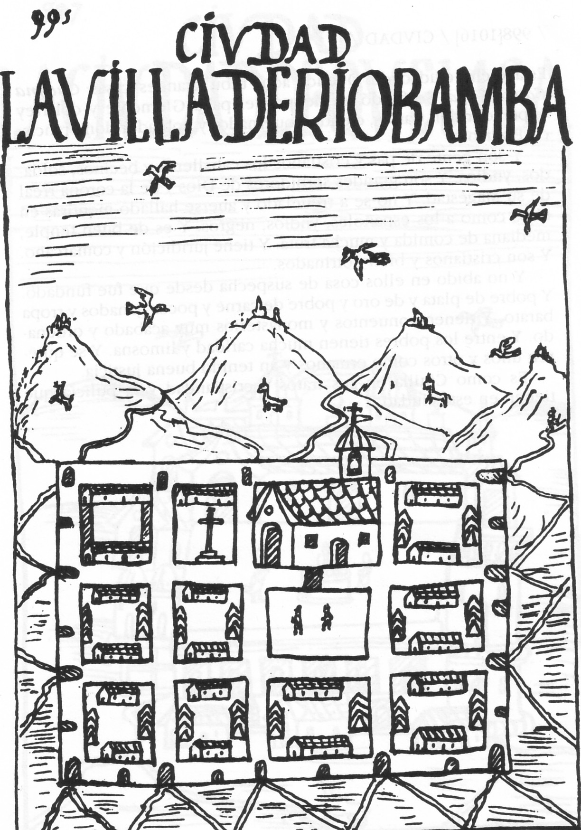
Nome del corso
Reducciones and
reconstruction
of the space
Latin American Anthropology
Sofia Venturoli

Slide 9
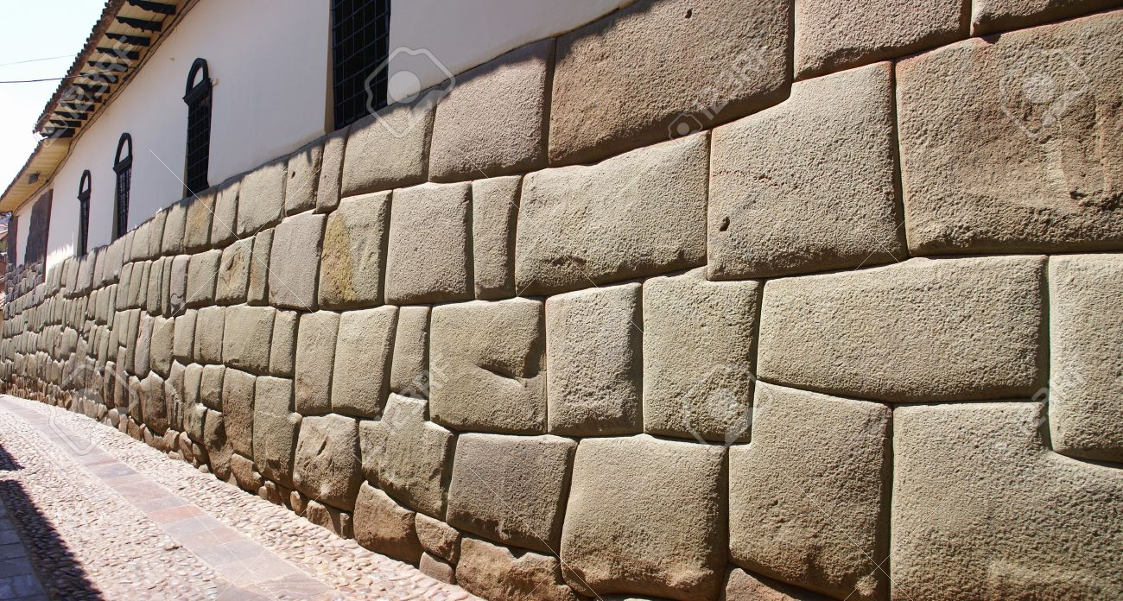
Latin American Anthropology
Sofia Venturoli
Notes:
9
9

Slide 10
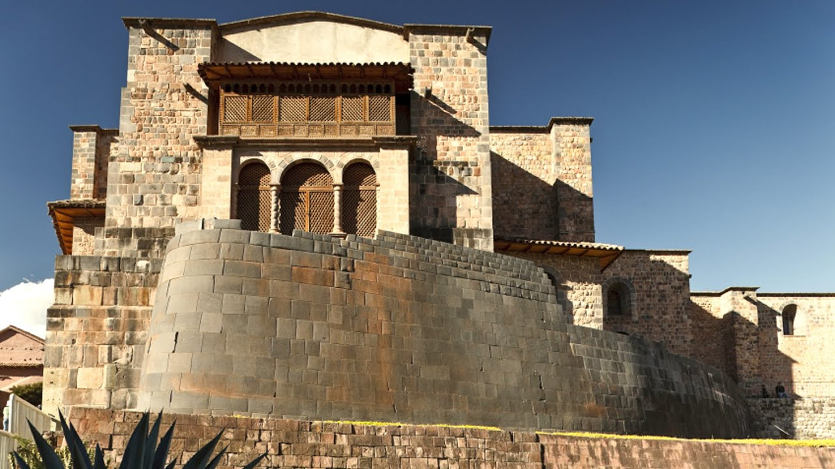

Slide 11
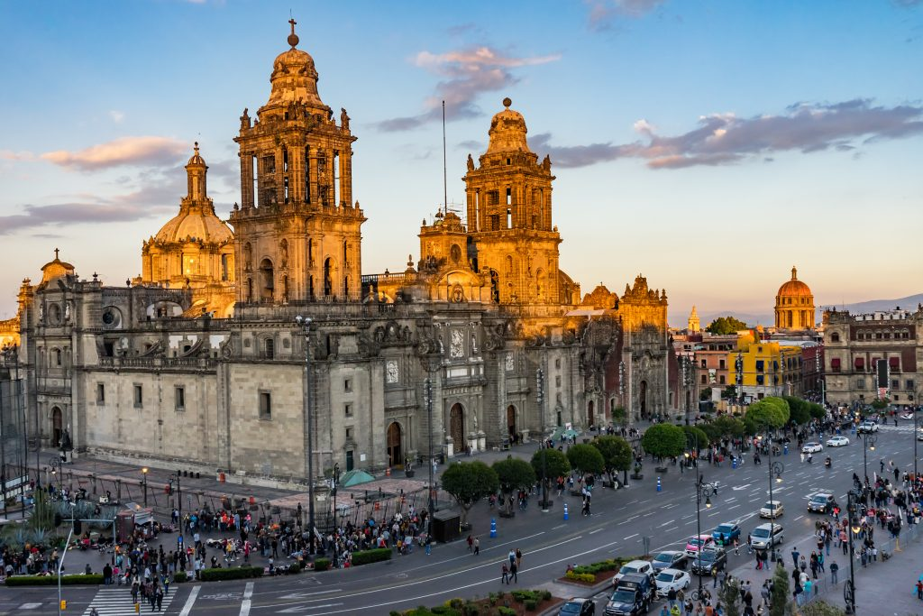

Slide 12
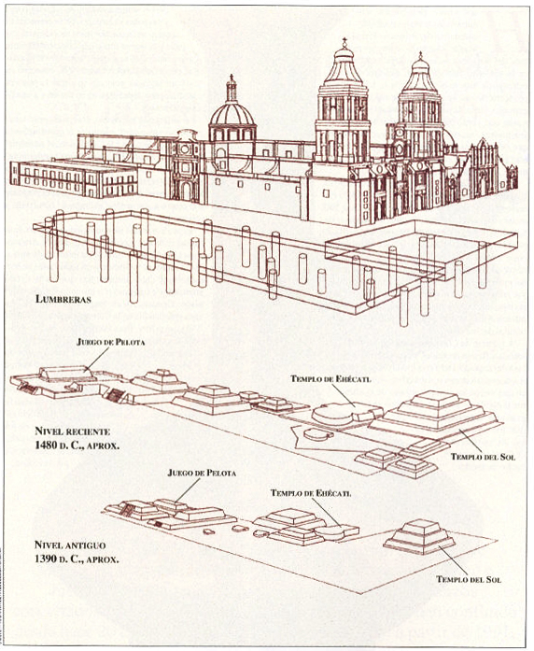
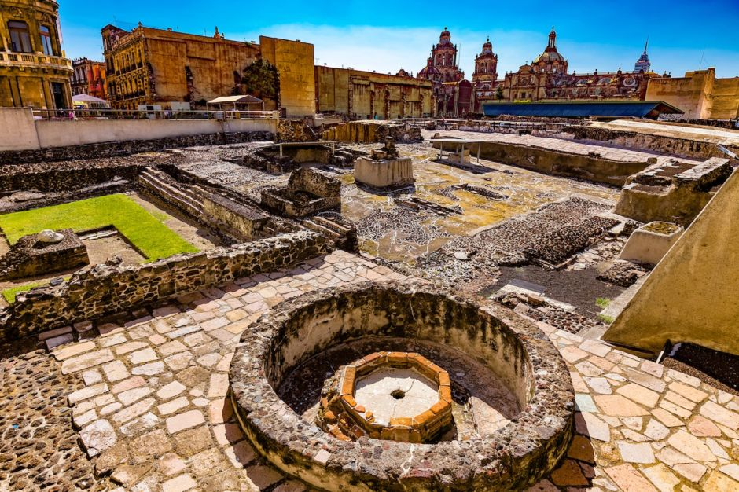
Templo Mayor
Latin American Anthropology
Sofia Venturoli

Slide 13
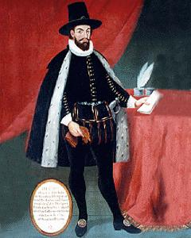
The Visitas Generales and the Relaciones geográficas de Indias
Latin American Anthropology
Sofia Venturoli

Slide 14
Handbook for the extirpation of idolatry
Latin American Anthropology
Sofia Venturoli

Slide 15
Spanish Chronicles
Latin American Anthropology
Sofia Venturoli

