Slide 1
Afro-feminism
2023/24
Latin American Studies

Slide 2
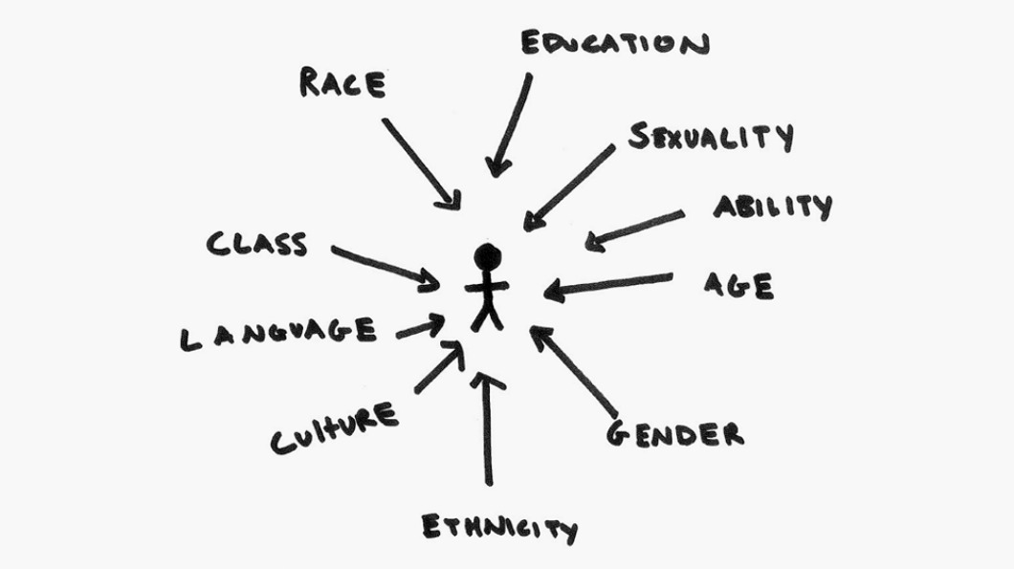
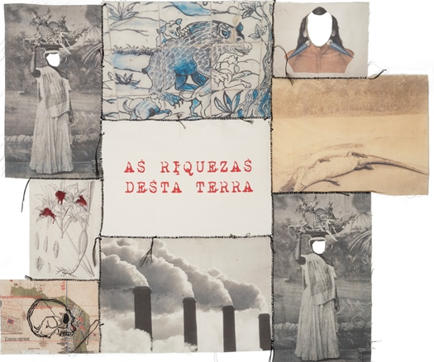
Intersectionalism
Nome del corso
A perspective that focuses on the intersection of different and multiple systems of domination: racism, sexism, classism… (Kimberlé Crenshaw)
The exclusion of the afrodescendant and indigenous people from the national building process, not only practically but even politically and ideally: colonialidad
Using an intersectional perspective does not mean adding the discriminatory effects produced by class, race, ethnicity and gender, but rather analyzing the singularity of gender experiences that originate the intersection between these relationships (Mara Viveiros 2017, p. 52).
Latin American Studies
Sofia Venturoli – Ingrid D’Esposito

Slide 3
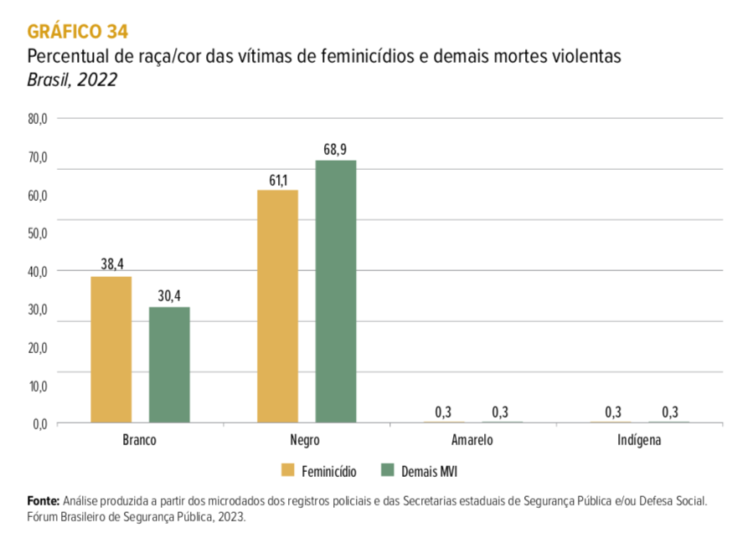
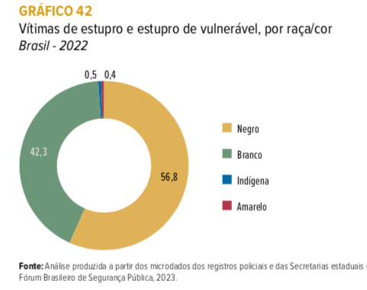
Latin American Studies
Sofia Venturoli – Ingrid D’Esposito

Slide 4
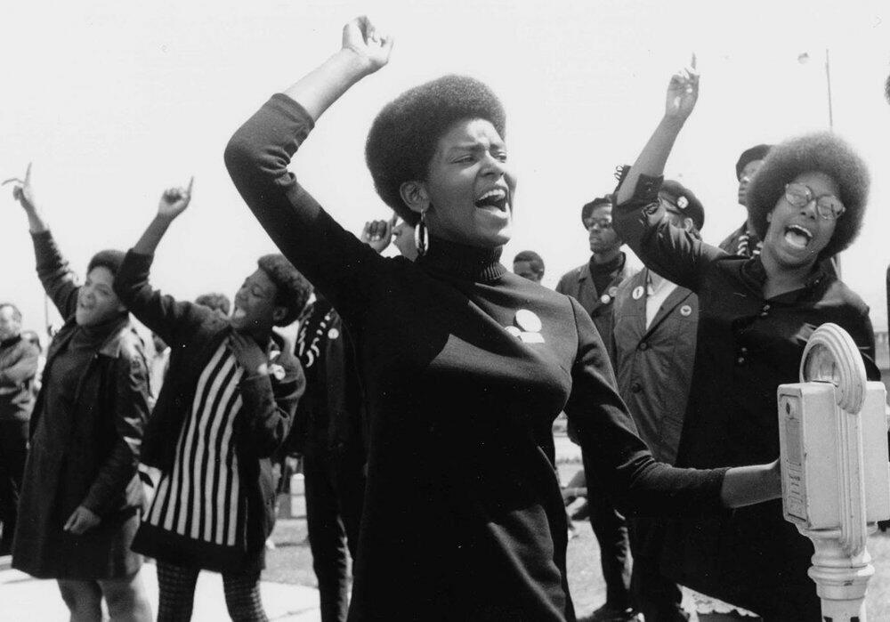
Brazilian Black Feminism
Nome del corso
1975 → Presentation of the Black Women Manifesto
Eighties and Nineties → More systematic organization and creation of new collectives.
2000 → Foundation of Articulação de Mulheres Negras Brasileiras (AMNB).
In 2001 there was in Durban the Third Conference against Racism, Xenophobia and Religious Intolerance
The 18th of November of 2015 First Marcha das Mulheres Negras contra o Racismo, a Violência e pelo Bem Viver
Latin American Studies
Sofia Venturoli – Ingrid D’Esposito

Slide 5
Black Feminist Thought
“When we speak of the myth of feminine fragility, which historically justified the paternalistic protection of men over women, what women are we talking about? We black women are part of a contingent of women, probably in the majority, who have never recognized this myth in themselves, because we have never been treated as fragile. We are part of a contingent of women who worked for centuries as slaves in the fields or on the streets, as salespeople, greengrocers, prostitutes. . . Women who did not understand anything when feminists said that women should take over the streets and work! […] When we talk about breaking with the myth of the queen of the home, of the idolized muse of poets, what women are we talking about? Black women are part of a contingent of women who are not queens of anything, who are portrayed as anti muses in Brazilian society, because the aesthetic model of women is the white woman” (Carneiro 2003, 50-51).
Latin American Studies
Sofia Venturoli

Slide 6
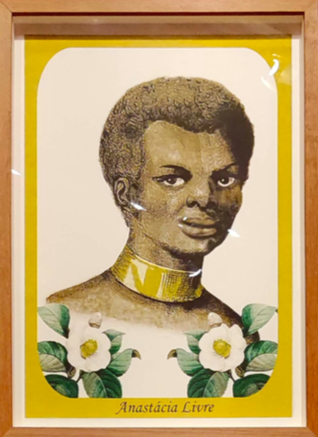
Against the Epistemic Violence
I want to speak about that brutal mask of speechlessness.
This mask was a very concrete piece, a real instrument, which became a part of the European colonial project for more than three hundred years. (…) Formally, the mask was used by white masters to prevent enslaved Africans from eating sugar cane or cocoa beans while working on the plantations, but its primary function was to implement a sense of speechlessness and fear, inasmuch as the mouth was a place of both muteness and torture.
In this sense, the mask represents colonialism as a whole. It symbolizes the sadistic politics of conquest and its cruel regimes of silencing the so-called ‘Others:’ Who can speak? What happens when we speak? And what can we speak about? (Kilomba 2010, 16)
Monumento à Voz de Anastácia, Yhuri Cruz, 2019
Latin American Studies
Sofia Venturoli

Slide 7
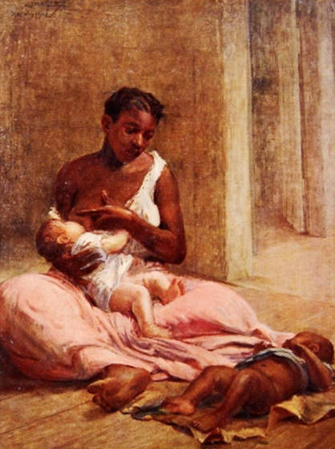
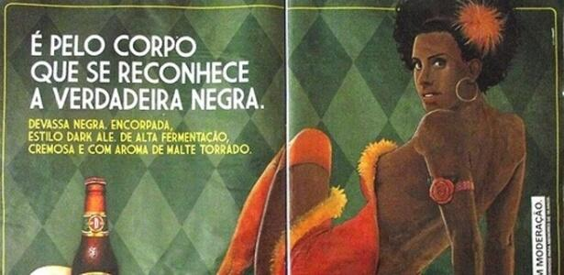
Against the Symbolic Violence
Latin American Studies
Sofia Venturoli – Ingrid D’Esposito

Slide 8
Decolinizing «Woman» Category
Lélia Gonzalez, in problematizing the subject of feminism, suggests the category “amefricanas” (Amefricans) to refer to the “heirs of another ancestral culture whose historical dynamics reveal differences from the vantage point of racial inequality” (1988a, 2). She uses this concept as a possibility for epistemological reflection that is able to bring out different traditions of resistance to patriarchal relations through the experiences of Black and indigenous women of Latin America, the Caribbean, and Brazil (Cardoso 2016, 18).
Jurema Werneck (…) delves into Afro-Brazilian culture and vindicates the figure of Ialodê, a term within the Afro-Brazilian tradition (…) of Candomblé that refers to “emblematic women, female political leaders who carry out their activities in urban settlements, in cities” (2007b, 68). The figure of Ialodê, like that of the Amefricans, operates from a logic that emerges from an Afro-Brazilian cosmovision, illuminating the different types of femininity that Black women live; thus, it de-centers the category of woman and the universalist brand of femininity produced by a white, Western Judeo-Christian logic (ibidem).
Latin American Studies
Sofia Venturoli – Ingrid D’Esposito

Slide 9
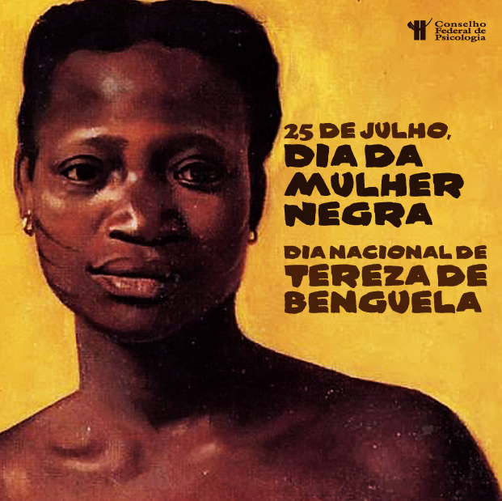
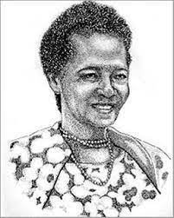
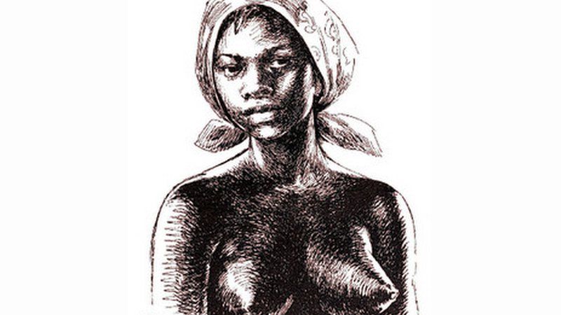
Other black women representations
Dandara dos Palmares
Luiza Mahin
Latin American Studies
Sofia Venturoli – Ingrid D’Esposito

Slide 10
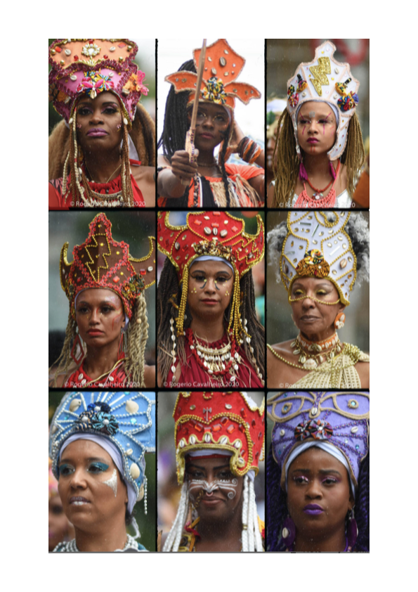
Ancestralidade
“Black women have always been powerful in the Candomblé terreiros, female power is present in Candomblé (...) Knowing the Yabàs means knowing a cosmo-perception, a way of being and being in the world in a different way. The Yabàs are images of strength that remove women from the position of fragility within white society. The idea of strength is intrinsic and part of our ancestral experience, we must recover it and remember it. The feminist struggle is part of our history as descendants of these ancestors!” (W., 5/10/2020).
Latin American Studies
Sofia Venturoli – Ingrid D’Esposito

Slide 11
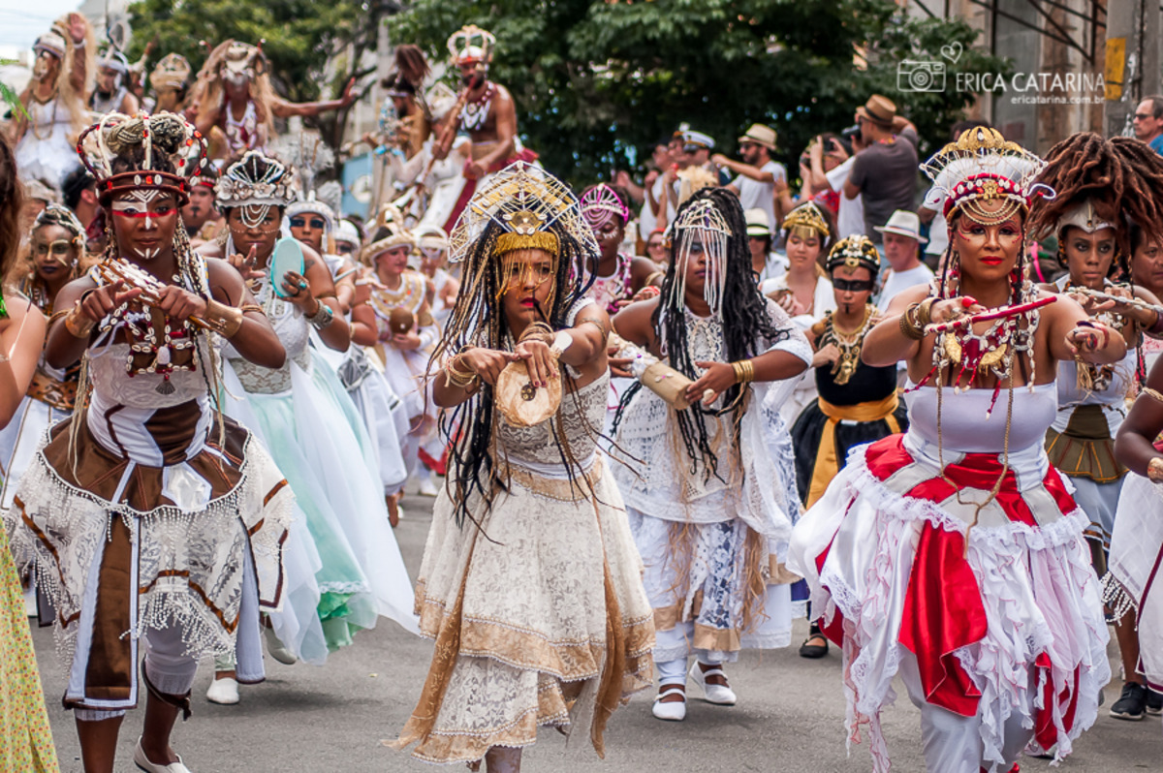
Ilu Oba de Min:
«Mulheres guerreiras unidas esse mundo vamos dominar!»
Com minha raça e minha cor
Eu solto meu grito no ar
Muito sangue ainda escorre
Isso tudo precisa acabar
Você não vê porque está dormindo
Não percebe que está alienado
Eu estou de olho aberto
O quilombo não está no passado
Dandara dos Palmeres, Luiza Mahin,
Mariana Crioula, Tereza de Benguela
Não sou a rainha do lar
É melhor acordar
Movimento é de resistência
Viemos protestar
Meu corpo, meu território
Meu filho, minha cor
Movimento de uma batalha
Resistência, coragem e amor
O medo acabou
Vamos bater, batucar
Mulheres guerreiras unidas
Esse mundo vamos dominar
Latin American Studies
Sofia Venturoli – Ingrid D’Esposito

Slide 12
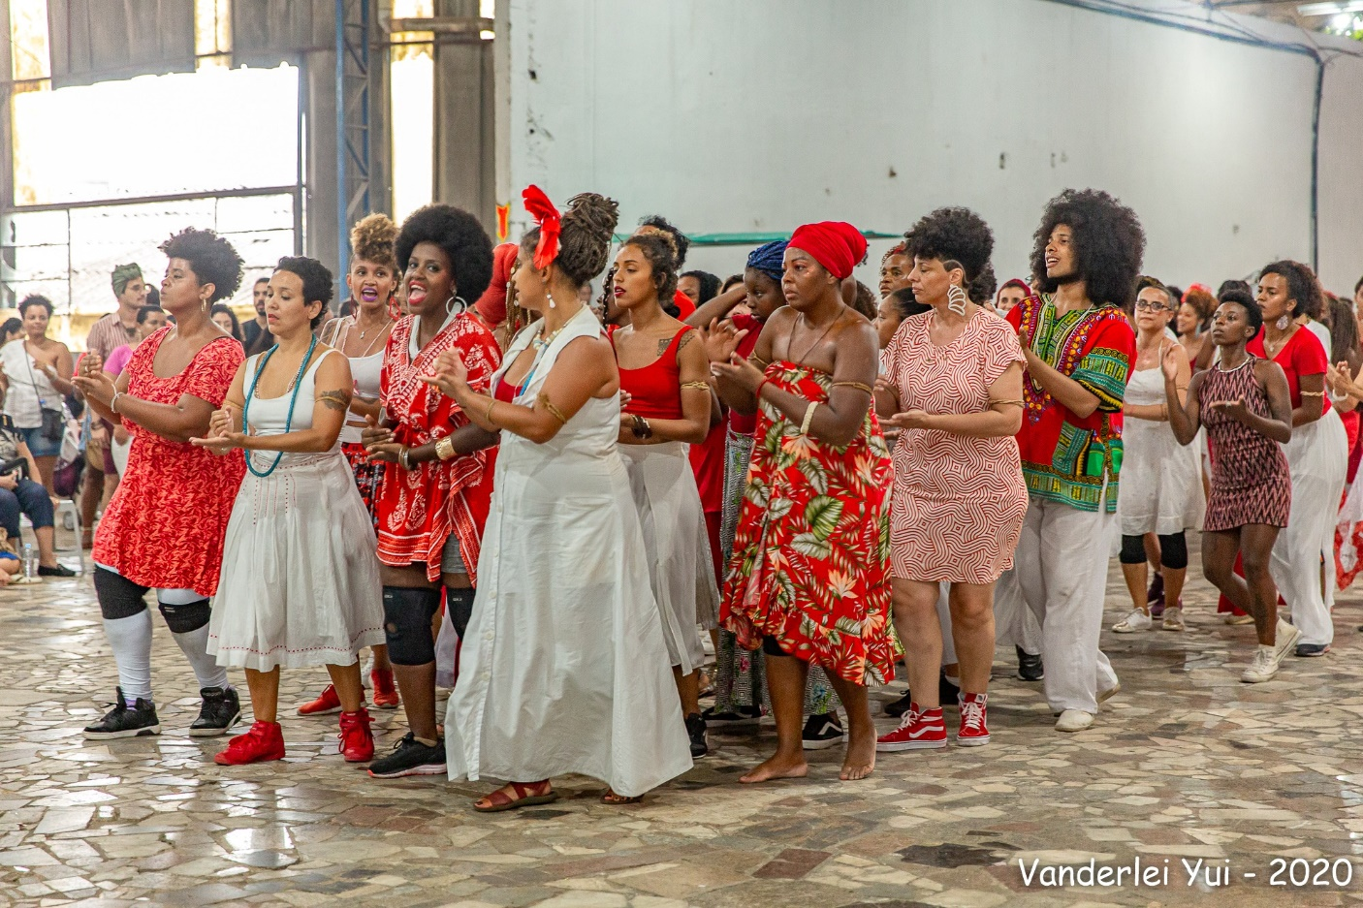
Multiple Femininities,
Multiple bodies
The Ilú Oba de Min is formed by women with different ages and bodies that represent the diversity of Black body (…) The Ilú as a whole has a great plurality which the dance group welcomes and highlights. This movement has a doble impact: it empowers people and lives, but it also breaks discourses and ways of seeing marked by structural racism. (…) Everyone looks at the dance group and I think that it’s important to provoke (…) Our political position is a provocative one (C., 8/7/2021).
Latin American Studies
Sofia Venturoli – Ingrid D’Esposito

Slide 13
Black Women Creating Spaces of Resistance, Empowerment and Healing
Latin American Studies
Sofia Venturoli – Ingrid D’Esposito

