Slide 1
Encounters and creation of t the Other
Sofia Venturoli
A.A. 2021/22
Latin American Studies

Slide 2
Nome del corso
«Son gente belicosa, e infra loro molti crudeli, e tute le loro armi e colpi son, come dice el Petrarca, comessi al vento, che son archi, saette e dardi e pietre; […] e quando combatono, s’amazano molto crudelmente e quela parte che resta signor del campo tutti e morti di loro bande li soterano e li nimici li speziano e se li mangiano». (Vespucci, 1984 [1502]: 81)
«[…] Viddi una certa città […] dove le carni umane, avendole salate, erano appiccate alle travi, sì come noi alle travi di cucina appicchiamo le carni di cinghiale […] e salsiccia e altri simil cose. (Vespucci, 1984 [1503]: 103).
«… non tengono né legge né fede nessuna. Vivono secondo natura. Non conoscono immortalità d’anima. Non tengono infra loro beni propri, perchè tutto è comune. Non tengono termini di regni o di provincia; non hanno re, né ubidiscono a nesuno: ognuno è signore di sé. Non amministrano giustizia, la quale non è loro necesario, perchè non regna in loro codizia» (Vespucci, 1984 [1502]: 79).
Latin American Studies
Sofia Venturoli

Slide 3
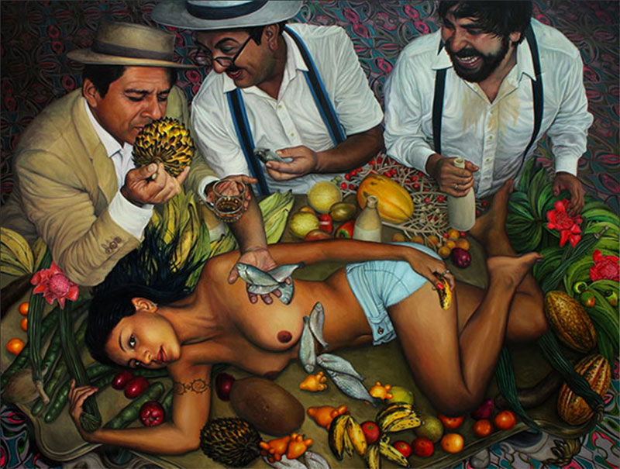
Nature and humanity: the Cannibal and The Amazon
Exotic mythical imaginary
Lack of moral and ethical values, and alphabetic writing
Main categories: nudity, anthropophagy, body decoration
The generic exotic other
Racialized Geography
Latin American Studies
Sofia Venturoli

Slide 4
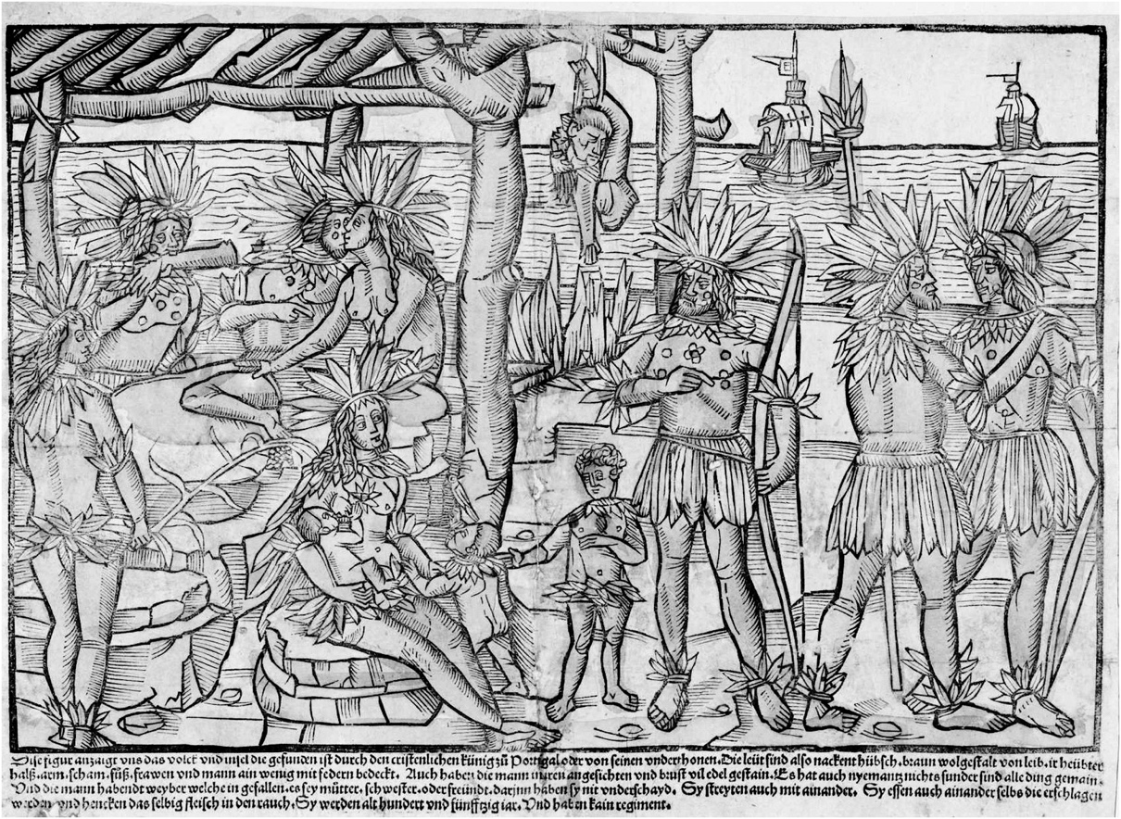
Nome del corso
Johann Froschauer, Woodcut of South American Indians, 1505, The New York Public Library.
Latin American Studies
Sofia Venturoli

Slide 5
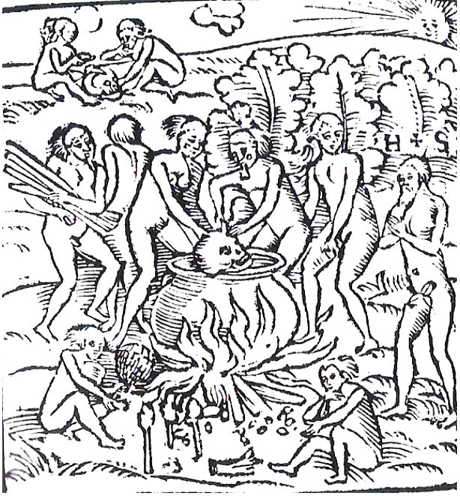
Nome del corso
Hans Staden woodcut of Brazilian natives from his work "Hans Staden: The True History of his Captivity" Original Text Accompanying: Tupinamba portrayed in cannibalistic feast observed by Staden (orig.1557).
Latin American Studies
Sofia Venturoli

Slide 6
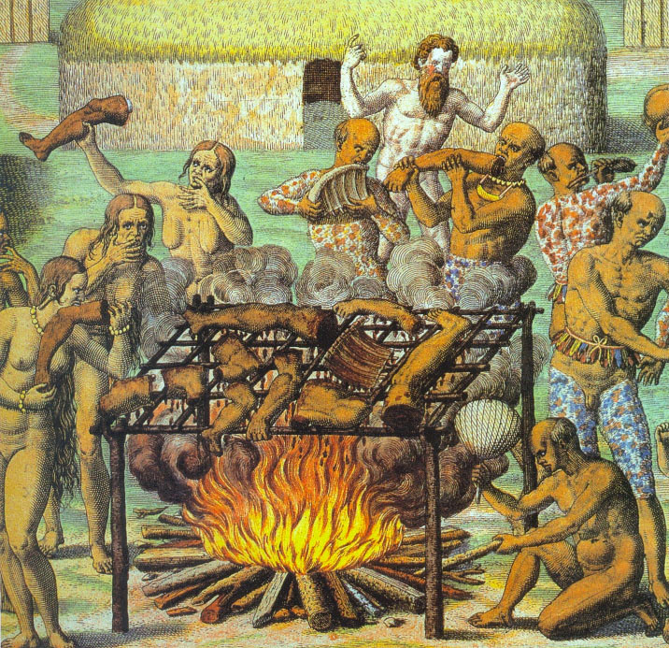
Nome del corso
Theodore de Bry, “Tupinamba men women and children eating the roasted limbs and trunk of the prisoner”, Le Grand Voyage, Part III, Frankfurt 1592.
Latin American Studies
Sofia Venturoli

Slide 7
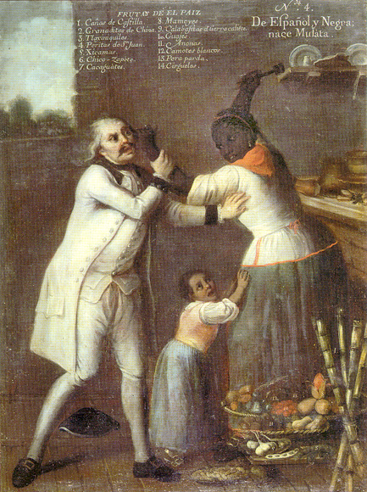
Europeans and the others: sem fé, nem lei, nem rei
Communication and lack of understanding
The doctrine of inequality: superiority and assimilation, proximity to the model of the human ideal
Alterity (otherness) is at the same time revealed and refused
American alterity is perceived through projection of preexisting cultural categories: assimilation or difference.
Latin American Studies
Sofia Venturoli

Slide 8
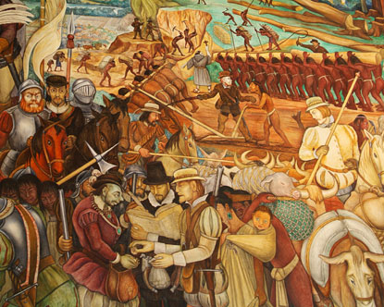
The polemica de los naturales: the dispute about the humanity of the indios
The Junta de Valladolid 1550; 1551
Bartolomé de Las Casas: equality and assimilation
Juan Gines de Sepulveda: hierarchy as a natural state of human society
Latin American Studies
Sofia Venturoli

Slide 9
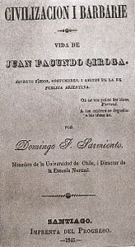
Civilización y barbarie
The process to independence as a new privilege criollo era
National Identity as a “quest of order”: progress and modernity
Inca si, Indios no: ambivalence in the barbarie vision, dichotomy of the cannibal/good savage
A small educated elite could build the path to progress against the backward masses
Continuity of the civilization-barbarism dualism into XX century
Notes:
9

Slide 10
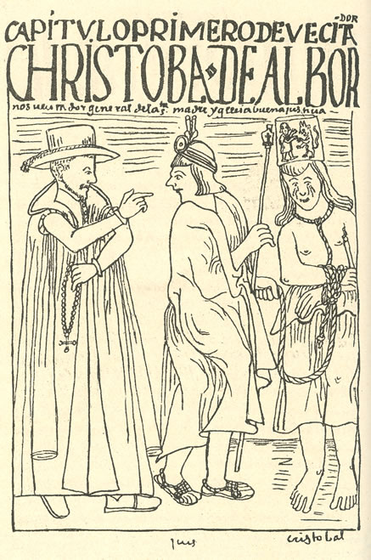
Taqui Onqoy
1564 Huamanga
pachacuti - messianism
the rearticulationg of huacas power
Albornoz idolatry extirpation
Integration of Spanish cultural concepts and structures in a process of reworking and appropriation.
These same concepts become tools for the reaffirmation of an identity and the assertion of socio-economic rights.

Slide 11
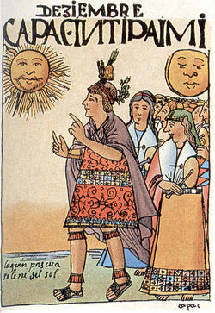
Evangelization
is the supreme good and the only justification for the conquest

Slide 12
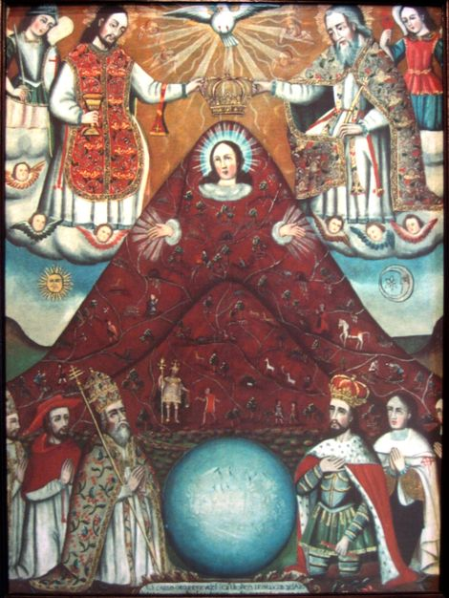
The Church as a “Westernizing” actor
Among the lower classes the mestiza religion, with its periodic rites, the proliferation of the cults of Saints and various manifestations of the Virgin Mary, and with its innumerable organizations and fraternities, becomes a vehicle of social inclusion and integration among different races.
Latin American Studies
Sofia Venturoli

Slide 13
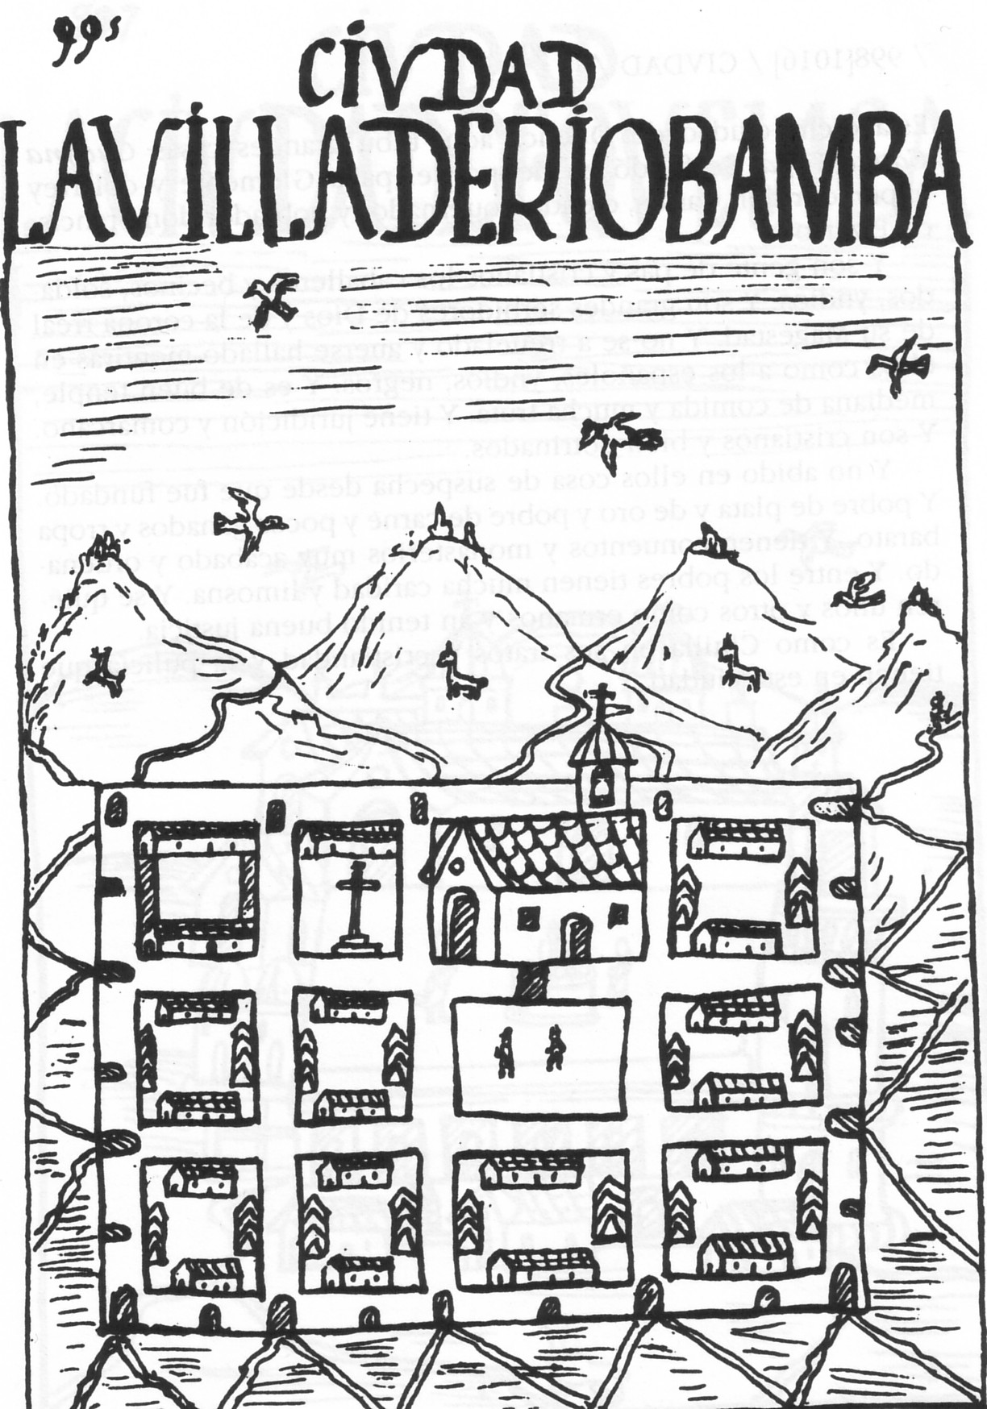
Nome del corso
Reducciones and
reconstruction
of the space
Latin American Studies
Sofia Venturoli

Slide 14
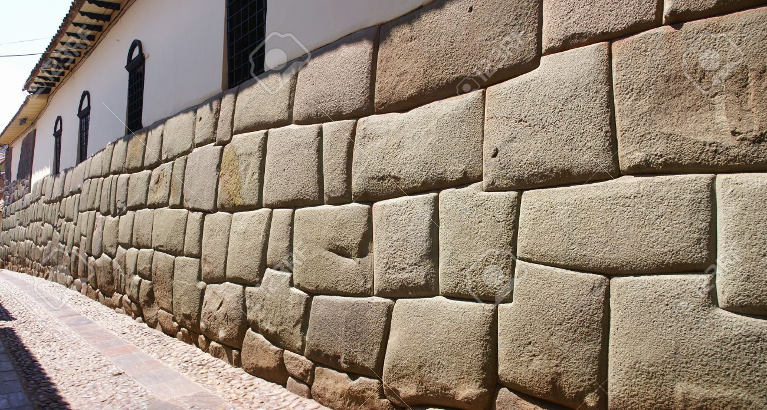
Latin American Studies
Sofia Venturoli
Notes:
14
14

Slide 15
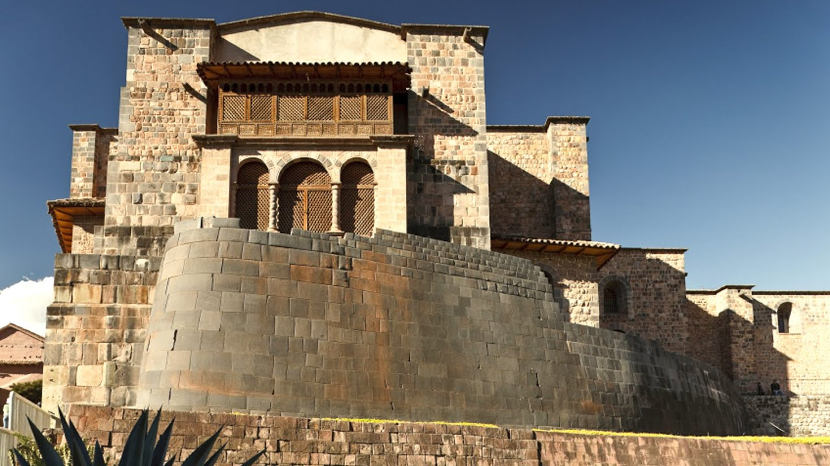

Slide 16
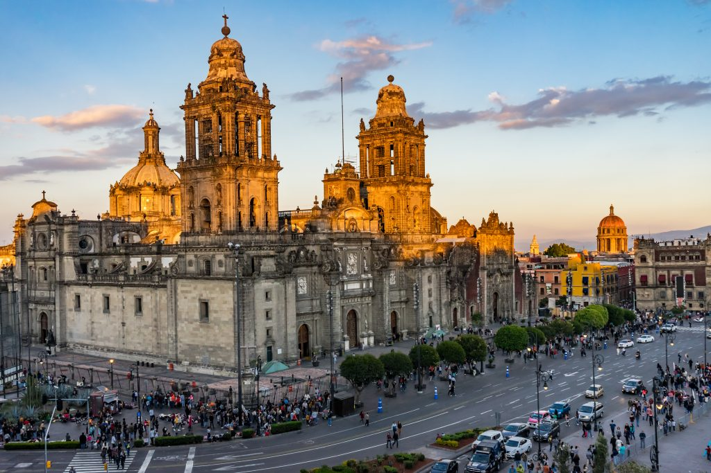

Slide 17
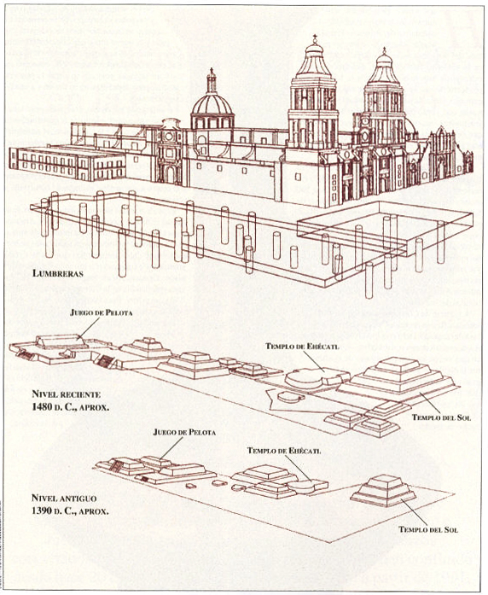
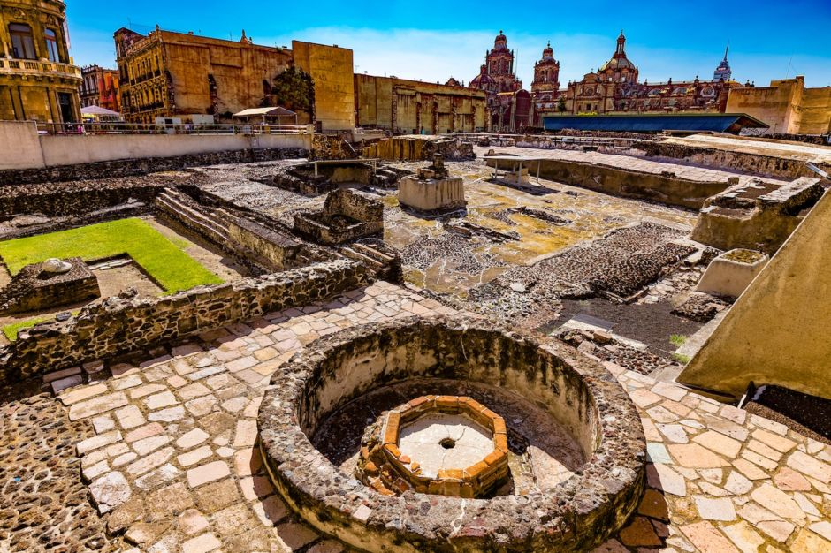
Templo Mayor
Latin American Studies
Sofia Venturoli

Slide 18
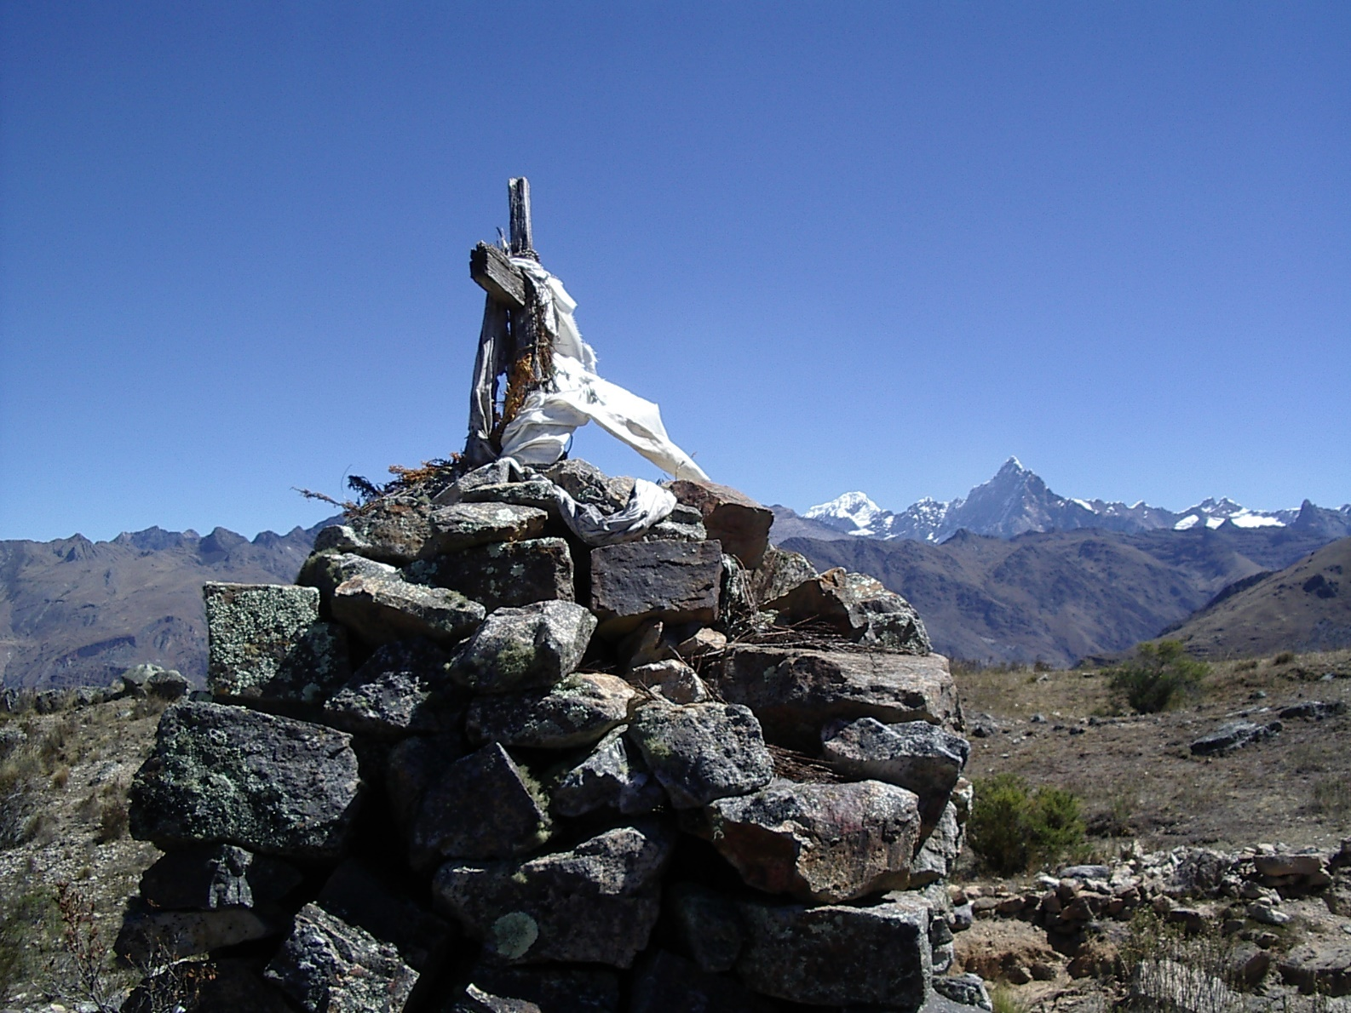
Nome del corso
Huacas
Latin American Studies
Sofia Venturoli

Slide 19
Nome del corso
Gloria Anzaldua Borderlands-la frontera
Una lucha de fronteras / A Struggle of Borders Because I a mestiza,
continually walk out of one culture
and into another, because I am in all cultures at the same time,
alma entre dos mundos, .tres, cuatro,
me zumba la cabeza con lo contradictorio.
Estoy norteada por todas las voces que me hablan simultaneamente.
Latin American Studies
Sofia Venturoli

Slide 20
Nome del corso
“In order to have History you must be colonized” (Mignolo 2005)
Modernity doesn't exist without colonization: one history prevails over the others
Evangelization as the language of salvation
America as a European construction
Ideological construction of racism as a fundamental new categorization of humanity to build the basis of the new hierarchical order
Latin American Studies
Sofia Venturoli

