Slide 1
Boats: are they vehicles?
Case C-428/02 Fonden Marselisborg Lystbådehavn (FML) v Skatteministeriet

Slide 2
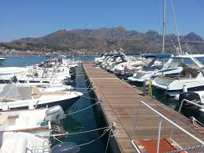
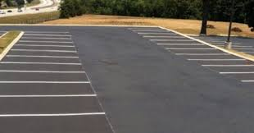
The ECJ
concluded that FML could regard as lettings both land sites and mooring berths (2005).
users of the land sites ... had exclusive use of sites assigned to them for a fixed period
users of water-based mooring berths: FML could let a mooring berth (when lessee was not using it)

Slide 3
An issue of analogy
To be decided by ECJ
How far do you stretch a provision?
An exemption can be enlarged to different objects?

Slide 4
Any letting is the same
“these temporary lettings did not alter the letting relationship between the lessee and the lessor”.

Slide 5
Exemptions from VAT
decisions of the European Court of Justice (ECJ), which interprets VAT law, have called into question VAT exemptions

Slide 6
Facts
Regional Tax Authority, Århus (Denmark): income from letting mooring berths was subject to VAT.
FML contested that decision before the Landsskatteret (Denmark).

Slide 7
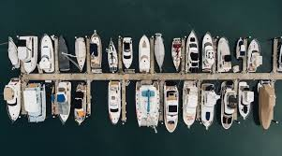
Preliminary questions
Must Article 13B(b)of the Sixth VAT directive be construed as meaning that the term 'letting of immovable property‘ includes the letting of a boat site ?
the term «vehicles» includes boats?

Slide 8
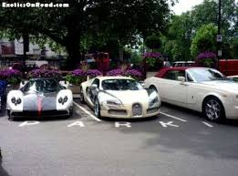
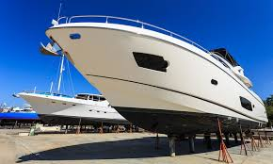
Conclusion
Article 13B(b)(..., must be interpreted as meaning that the definition of
'vehicles' includes boats.

