Slide 1
The Idea of Latin America
Sofia Venturoli
A.A. 2023/24
Latin American Studies

Slide 2
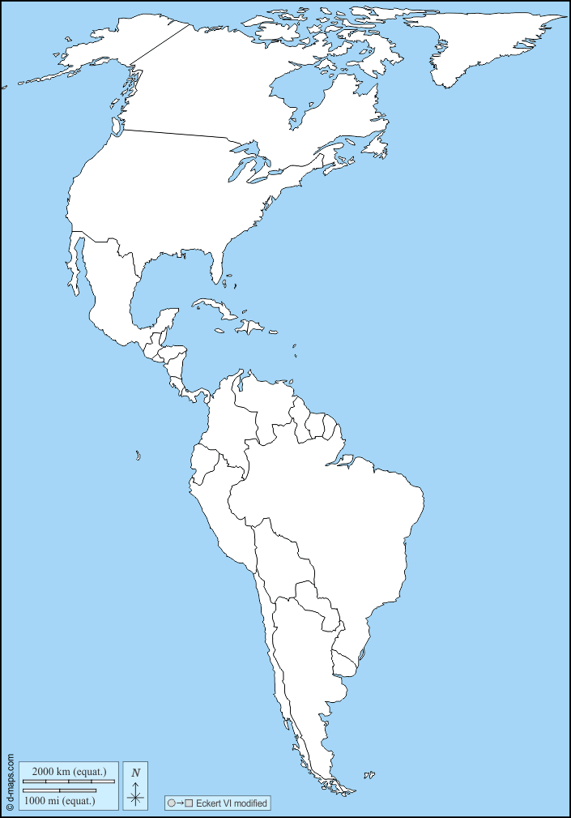
Where and What is Latin America?
Latin American Studies
Sofia Venturoli

Slide 3
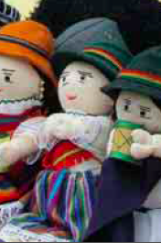
Latin America ethinc groups
indigenous populations in Latin America exceed 45 million people (IWGIA 2017), is the area with the highest indigenous density on the planet, 8.3% of the region's population.
826 indigenous peoples, of whom 100 are cross-border populations
more than 400 groups have less than 3000 components
about 200 groups are in voluntary isolation
Latin American Studies
Sofia Venturoli

Slide 4
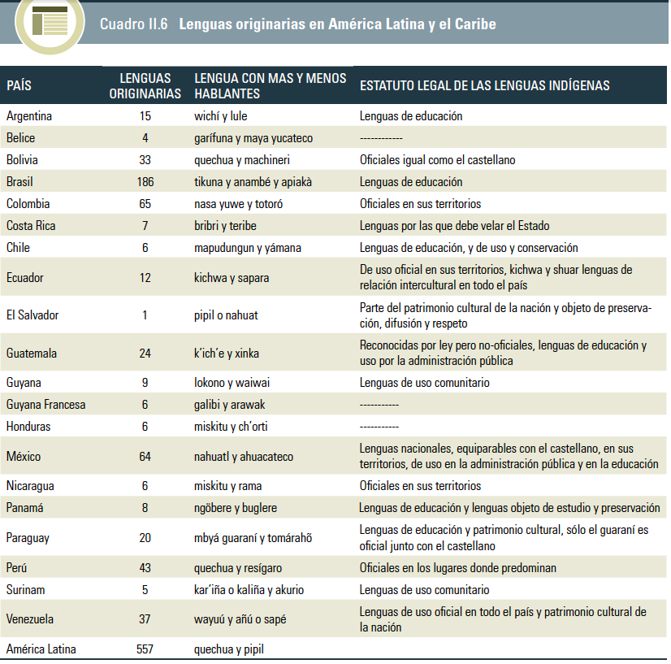
Nome del corso
Latin American ethno-linguistic diversity
Latin American Studies
Sofia Venturoli

Slide 5
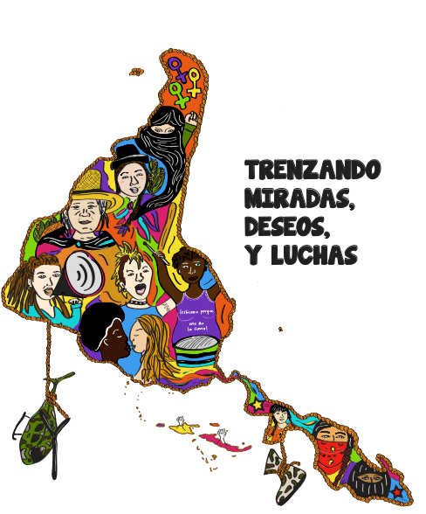
Abya Yala
Nome del corso
For Abiayala to Live, the Americas Must Die:
For Abiayala to Live, the Americas Must Die (Emil Keme 2018)
Renaming the continent is the first step towards epistemic decolonization and the establishment of our sovereignties or indigenous autonomies
Declaración de Quito de 1990: the first official indigenous document that uses the term Abya Yala in a political and collective way
The meeting “500 years of Indian resistance” took place in Quito, Ecuador, between July 17-21, 1990. It was attended by representatives of 120 indigenous nations of the hemisphere, International Organizations and non-indigenous solidarity organizations.
Abya Yala has become not only the name to refer to the continent, but also a place of differentiated indigenous cultural and political enunciation.
Latin American Studies
Sofia Venturoli

Slide 6
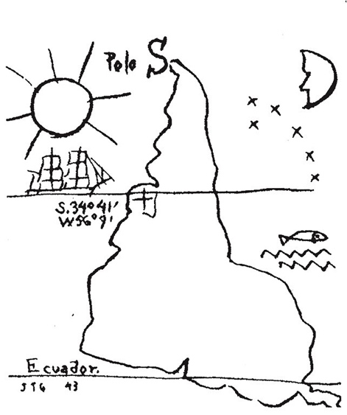
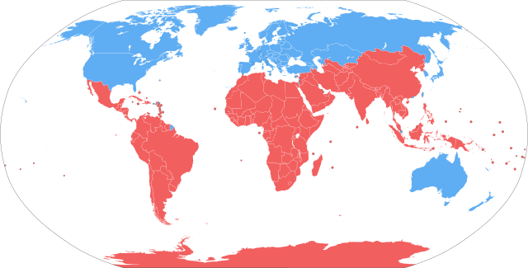
Locus of enunciation
Nome del corso
What does it mean to speak from the
North? Or, from the South? From the
Center or from the Peripheries?
De-construction of the traditional
Perspectives
Theoretical Perspective from the Global South:
Subaltern Studies
• Liberation & (De)Colonialism (Freire, Dussel, Quijano, Mignolo)
• South Epistemologies (Boaventura de Souza Santos)
• Anthropologies in Latin America (Activism and Participatory-Research-
Action)
Latin American Studies
Sofia Venturoli

Slide 7
Anibal Quijano,
La colonialidad del poder
Nome del corso
coloniality
Quijano claims that the idea of coloniality raises together with the arrival of the Europeans in the Americas and the institution of a new relation of political dominance that, opposing Europeans and non-Europeans, originated the category of modernity:
naturalization of a universalizing model of knowledge production that considers Europeans superior to any other group: “colonial matrix of power” (Quijano 1994)
Race and slavery
Latin American Studies
Sofia Venturoli

Slide 8
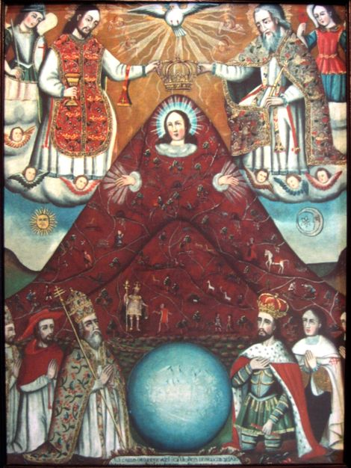
decoloniality
“I use a lot the questions of the “how” because I think the point is to not just what is decoloniality but how to practice, how to put into praxis a decolonial posture, attitude, action, how name, how to analyze the matrix of power present taking form today, and how to resist, how to refuse, how to insurge and resurge, and how to re-exist in these present times. How, as many peoples here in Abya Yala argue, how to sew and cultivate life where there’s death. These, I think, are only some of the crucial decolonial questions of these times that help us see that decoloniality is not a condition or a presence of the past, but it’s this continuing struggle today that begins to bring us together in some ways, to analyze the realities that we’re living in, but most of all to assume a praxis not just against this coloniality or colonial matrix of power, but for the possibilities of living, of thinking, of being, of sensing otherwise.” Catherine Walsh
Latin American Studies
Sofia Venturoli

Slide 9
The idea of Latin America
The idea of Latin America itself is inseparable from the idea of coloniality
America as a European construction
Ideological construction of racism as a fundamental new categorization of humanity to build the basis of the new hierarchical order
The geopolitical monopoly of knowledge: history, space
The Conquest of the America as a necessary condition for the European and western imperial expansion at epistemological level as a model of imposition of values based on the logic of coloniality but also economic (Mignolo).
Latin American Studies
Sofia Venturoli

