Slide 1
Indigenous people and Covid-19
Sofia Venturoli
A.A. 2020/21
Antropologia Culturale ed Etnologia

Slide 2
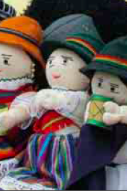
Latin America ethinc groups
indigenous populations in Latin America exceed 45 million people (IWGIA 2017), is the area with the highest indigenous density on the planet, 8.3% of the region's population.
826 indigenous peoples, of whom 100 are cross-border populations
more than 400 groups have less than 3000 components
about 200 groups are in voluntary isolation
Latin American Anthropology
Sofia Venturoli

Slide 3
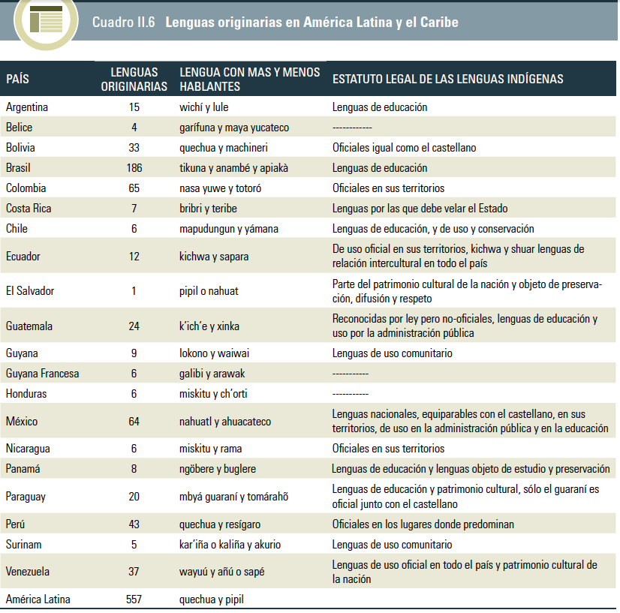
Nome del corso
Latin American ethno-linguistic diversity
Latin American Anthropology
Sofia Venturoli

Slide 4
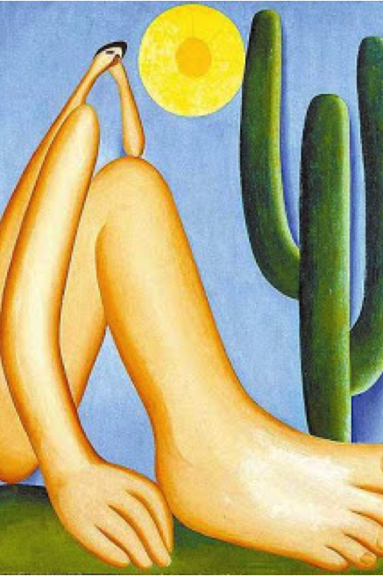
Parameters of vulnerability
They live in areas far from urban centres, the have restrictions to basic services, including water and health centres
Many indigenous lands suffer the degradation of the natural environment in which and from whose resources they live
They speak languages other than national ones through which information on the disease and emergency is disseminated
They express different approaches to illness than those contemplated by the WHO, by national medical structures, and by the media.
Some communities are in an even greater state of vulnerability due to the small number of their representatives, the entry of the virus into community could mean the definitive extinction of their ethnicity
Latin American Anthropology
Sofia Venturoli

Slide 5
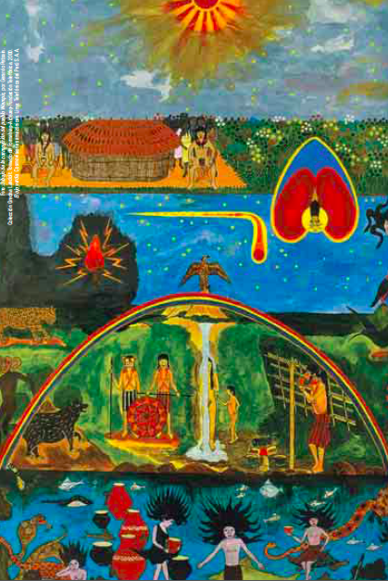
Different Level of risk
Indigenous peoples in voluntary isolation, due to their isolation, have a much weaker immune system against external pathogens
Recently contacted indigenous peoples are also at different levels of immunological risk.
Indigenous peoples in communities or in indigenous lands with an ancient and continuous contact with the national community are in conditions of risk for previous debility: high rates of childhood anaemia and malnutrition, ease of respiratory infections, others epidemics and malaria…
Latin American Anthropologyc
Sofia Venturoli

Slide 6
Not only a the disease
“It seems likely that we will come to see in the next year a painful scenario in which some human creatures assert their rights to live at the expense of others, re-inscribing the spurious distinction between grievable and ungrievable lives, that is, those who should be protected against death at all costs and those whose lives are considered not worth safeguarding against illness and death” (J. Butler 2020)
“En esta pandemia no estamos todos en el mismo barco, estamos en el mismo mar; unos en yate, otros en lancha, otros en salvavidas y otros nadando con todas sus fuerzas” (Organizaciones Indígenas Estado de Hidalgo)
Racial stigmatization of indigenous and black people
Increase of political tensions: health emergency - political emergency
The informal sector in urban area
Space-race-hygiene
Latin American Anthropology
Sofia Venturoli

