Slide 1
Indigenous Movement in the Land of Santa Cruz - The Politicization of Ethnicity or A Colonial Chapter of a Political Anthropology.
Renato Athias
Turin, 17th November 2022

Slide 2
1. Moment - Know to conquer – “People without soul”
Three Facts/Three Situations
a) The New and the Old World
Best Seller: Hans Staden [Cannibalism]
b) The nations of the earth;
“Dialogues of the Greatness of Brazil”
c) Educating for Assimilation
“Directory of Missions”

Slide 3
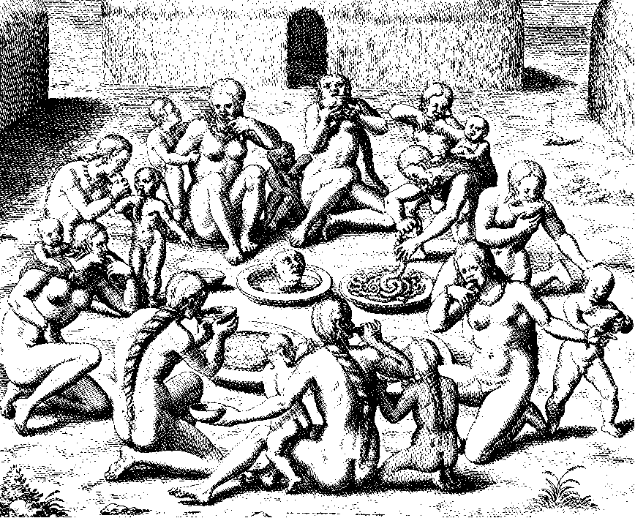

Slide 4
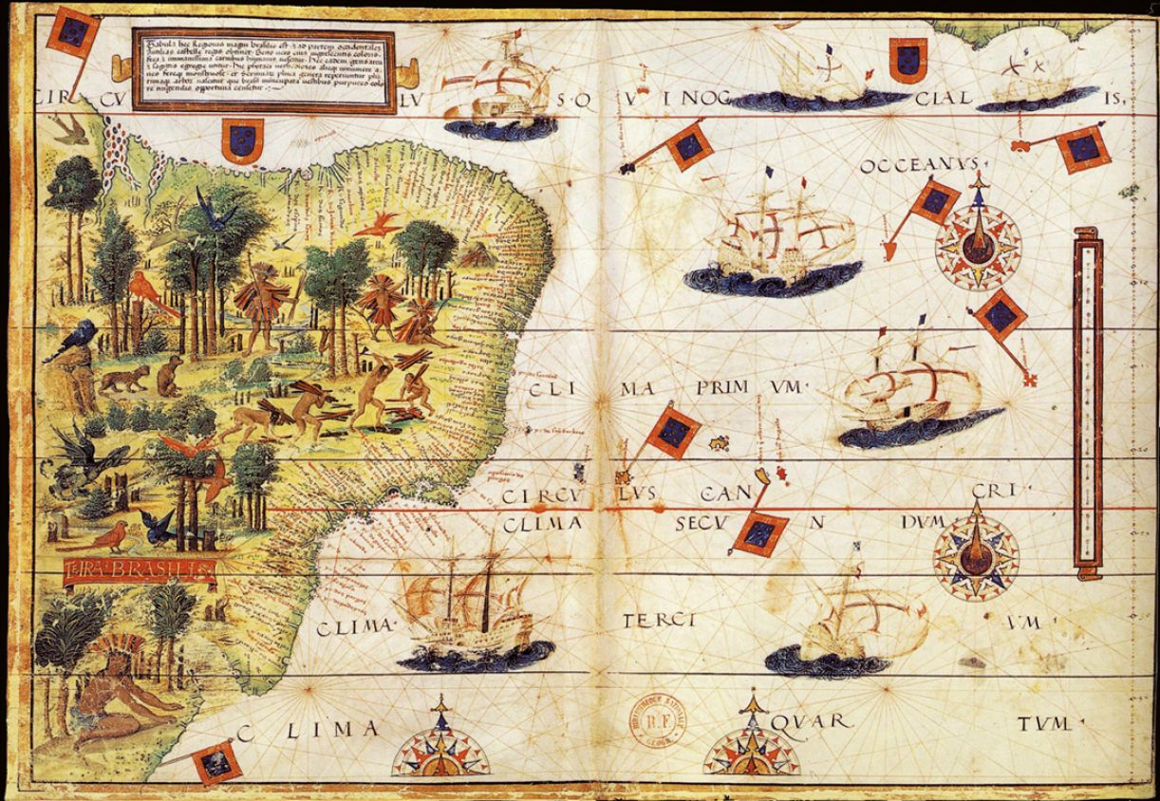

Slide 5
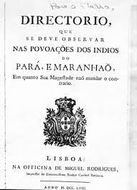
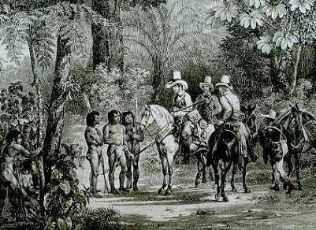
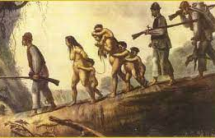

Slide 6
2. Moment - Which side are you on?
Events put indigenous contingents fighting alongside the Portuguese.
Fight to gain space. The treatment of historiography.
War against the "Dutch"
War against the French
War against Paraguay - [in exchange for land]

Slide 7
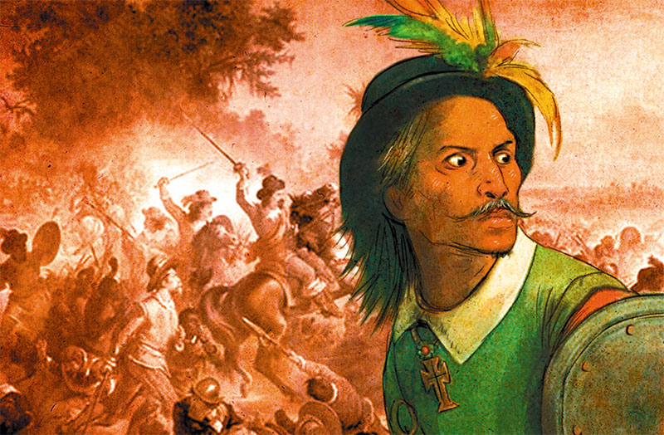
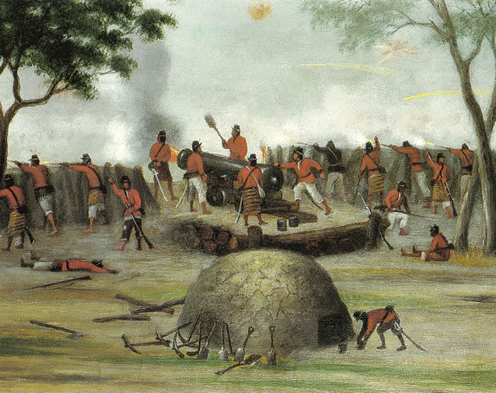

Slide 8
3. “Tutela” - You are on “our” on the “Brazilian side”
The “Silvícolas” are part of the Federal Constitution - As a Social Category with specific legislation.
Inclusion policies / excluding
Protection Service for Indigenous Peoples and National Workers (SPI)
Indigenous land policies;
Emergence of an Indigenous/Indigenist Anthropology - Political Anthropology
The Barbados document – 1970
Incorporation/Inclusion of indigenous movements in national insurgencies would make a great analysis.
The United Nations and Indigenous Peoples [Universal category] Subjects of law.

Slide 9
Three events:
The Indigenous Assemblies promoted by CIMI – 1974 a 1985
Emergence of Indigenous organizations in the 1980s
By International Cooperation – Conv. 169
New Constitution - Fall of Tutela
Self Representation…

