Slide 1
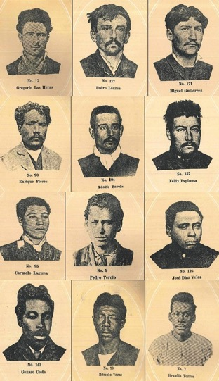
Afro-Argentines. Expansion and consolidation of an interdisciplinary field of study
The Police construction of racial profiles in the city of Buenos Aires.
Santiago Manuel Gimenez.PhD candidate.
PhD programme in Psychological, Anthropological and Educational Sciences.
University of Turin.

Slide 2
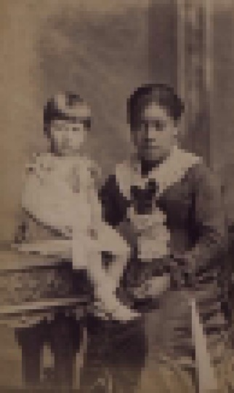
New perspectives 80's and 90's
Interdisciplinarity. Identities of Afro-descendant populations as historical processes. Specific contexts and interactions.
Resistance actions by black slaves and their descendants.
Afro-descendants and their role in current Latin American societies.
Classics studies
Beginning of the 20th century. Anthropologists and Ethnohistorians showed interest in different aspects of the populations who descended from African slaves.
Folk studies. Essentialist perspective.
Historical studies. Description of the period of slavery during the colonial times.

Slide 3
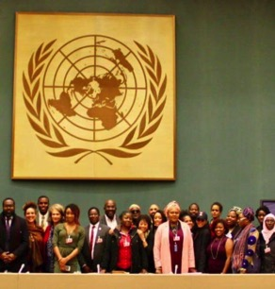
Plan de Acción de Santiago. Regional Conference of the Americas. Santiago de Chile, 2000.
World Conference against Racism, Racial Discrimination, Xenophobia and Related Intolerance. Durban, South Africa, 2001.
Strongly promoted academic studies
“ Ignoring the existence of discrimination and racism, at both the State and the society level, contributes directly and indirectly to perpetuating the practices of racism, racial discrimination, xenophobia and related intolerance.”
“ The identity of the Americas cannot be dissociated from its multiracial, multiethnic, multicultural, multilingual and pluralistic character; a diversity that constitutes a contribution to human coexistence and the construction of cultures of mutual respect and democratic political systems”.

Slide 4
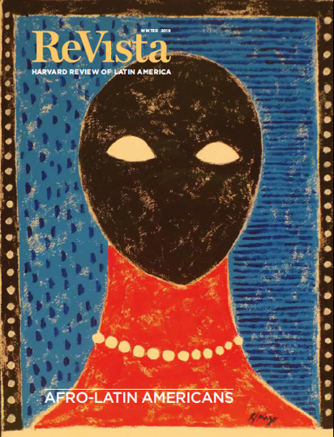

Slide 5
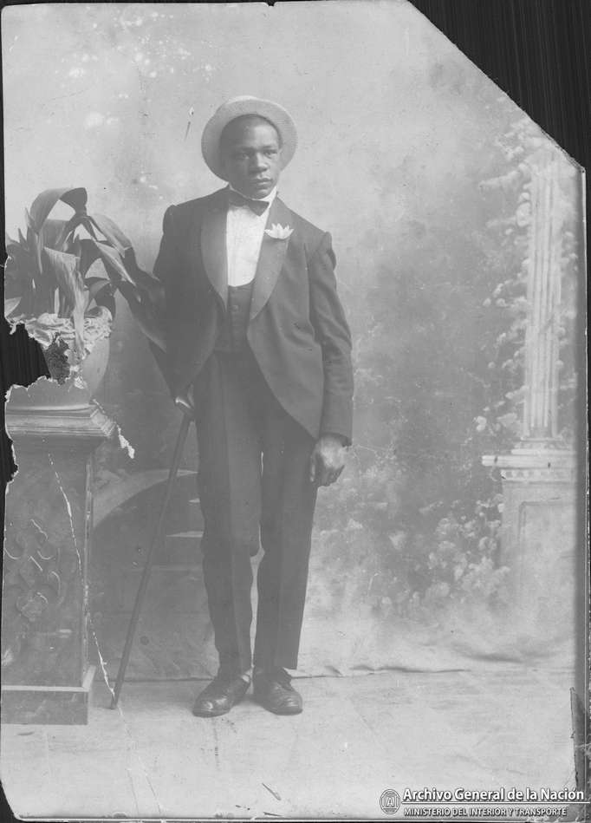
Hypotheses of disappearance
Epidemics over the course of the nineteenth century (particularly the yellow fever epidemic of 1871).
The overreliance on black soldiers as cannon fodder (carne de cañon) in wars, especially the Independence battles (1810–16) and the War of the Triple Alliance (1864–70, the “Paraguayan war”).
The decline in trade of enslaved. The abolition of trafficking (1853 in the provinces, 1861 in Buenos Aires) would mark the end of the large-scale importation of Africans.
Mestizaje – the idea that people of African descent (imagined as ever smaller in number) “mixed in” with lighter-skinned people (ever greater in number, especially during the period of mass immigration). Mixture as Whiteness.

Slide 6
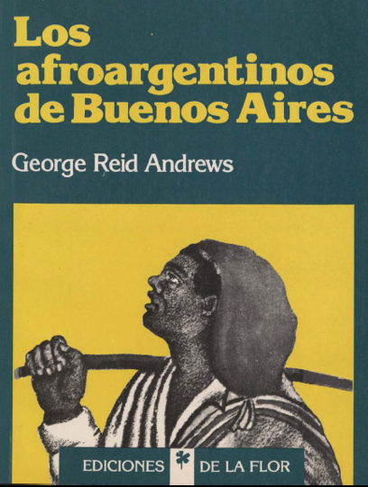

Slide 7
Renewal of studies in Argentina
Studies of racial categories in the Colony and Republican times (17th century to the first half of the 19th century)
Displacement of the analysis towards unexplored areas, both in time and space.
Multidimensional and contradictory nature of socio-racial stratification.
Inclusion of the gender variable.
Racial categories in Argentina in the XIX-XXI centuries
Racialized categories. Change, circulation and reproduction. Since the consolidation of the nation-state as a white-European project in the second half of the 19th century till the present.
Social micro-operations of concealment of blackness in pursuit of whiteness.
African migrations to Argentina in the 20th/21st centuries.
Subaltern perspective. Investigation of Afro-descendant periodicals. Newspapers and magazines of the community itself.
Visual studies. Analysis of sources never studied before. Media/ Social networks.

Slide 8
Racial profiling in Buenos Aires
The discriminatory practice by law enforcement officials of targeting individuals for suspicion of crime/delinquency based on the individual's physical characteristics.
1800
1900
2000
Estate-Nation
Social Control
New technologies to identify people
Development of Racial Profiling

Slide 9
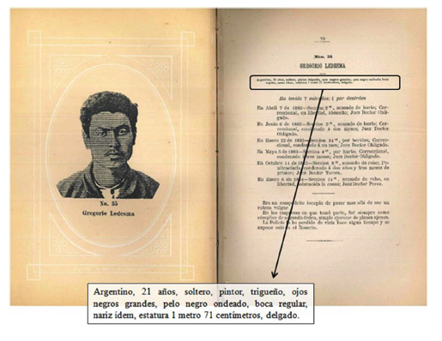
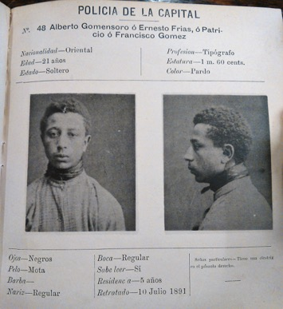
Criminal Galleries
Galería de Ladrones de la Capital 1880-1887
Galería de Ladrones conocidos 1902/1904

Slide 10
Racial ideas. Criminology.
Racial categories in Argentina. Binomial formation. White vs Black.
The concept of ‘race’ as a basic criterion for social classification under the process of colonial domination (Quijano, 2000), for the second half of the nineteenth century had been consolidated in European scientific racialism that understood ‘races’ as types, with based on a hierarchy of biological differences (Wade, 2000).
Criminal Galleries
Photographic images as scientific evidence

Slide 11
Blanco
Trigueño
Cobrizo
Pardo
Negro
Different ways of Whiteness
Color of the Skin
Blackness in Buenos Aires has been reduced to a very limited and specific set of physical
characteristics.
One way of Blackness
The classification of the Police contributes to the logic of Whiteness and Blackness in Buenos Aires.
How has the Police gaze that nowadays acts in terms of racial profiling been shaped through history?

Slide 12
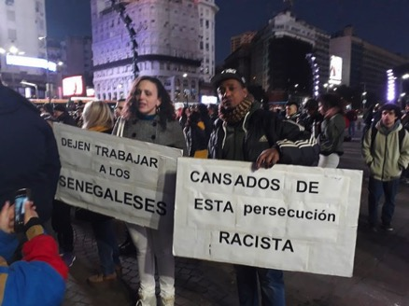
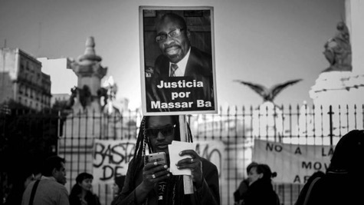

Slide 13
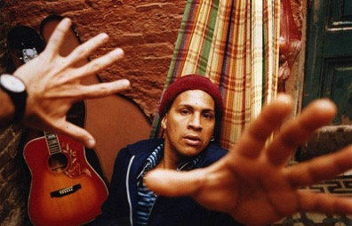
José Delfín Acosta Martínez was killed by the Buenos Aires police while defending two Afro-Brazilians from arbitrary detention
Argentina was convicted of racism by the Inter-American Court of Human Rights, in a ruling that attributes to the State responsibility for the murder of the Afrodescendant activist José Delfín Acosta Martínez, on April 5, 1996, by the Buenos Aires city police.

