Slide 1
THE PRODUCTION OF OTHER KNOWLEDGES AND ITS TENSIONS: FROM ANDEANIST ANTHROPOLOGY TO INTERCULTURALIDAD?
Marisol de la Cadena
Lucilla Chiesa
Eleonora Guzzo
Elena Alexandra Mariut

Slide 2
introduction
WESTERN HEGEMONY OF KNOWLEDGE: «western forms of knowledge and its practices are not confined to Europe or the US but have exceeded those territories.» (Marisol de La Cadena)
Latin American Anthropology was dominated by concepts like Mestizaje, Andeanism, and Cholificaciòn.
Interculturalidad against the hierarchical structures of knowledge.

Slide 3
The Inter-American Hub of Peruvian Anthropology

Slide 4
The main characteristics of andean anthropology
INDIGENISTAS: Group of intellectuals raising the problems of indigenous communties (political doctrine) with a paternalistic approach. Source of ideas of mestizaje.
MESTIZAJE : Population-making tool that promised the uplifting of indigenous population to a higher level of civilization by draining off their backwardness
CHOLIFICACIÓN: Process meant to describe the transformation of Indians into cholos, their de-indianization yet incomplete integration to western ways of being and knowing (Anibál Quijano)
LO ANDINO: Anthropological notion describing Andean community and culture. Essentialization and generalization of andean cultural practices

Slide 5
All the Bloods: Arguedas as an Unthinkable Epistemological Revolution

Slide 6
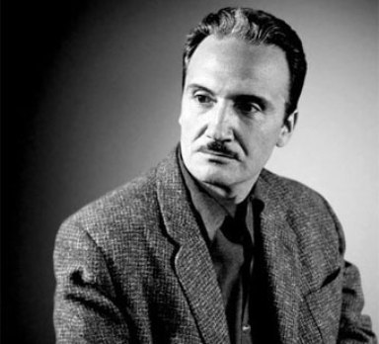
JOSé MARIA ARGUEDA (1911-1969)
Peruvian literary writer and anthropologist.
Challenged the mainstream theories developed in the 1960s and the silent hegemony of western forms of knowledge → promotion of cultural diversity and re-direction of the debate from Mestizaje to Interculturalidad.
Self-identified as “a civilized man that has not stopped being at the core an indigenous Peruvian”→ challenge to the nationalist theology of mestizaje.
He has been strongly criticized by the most prominent intellectuals of that time.

Slide 7
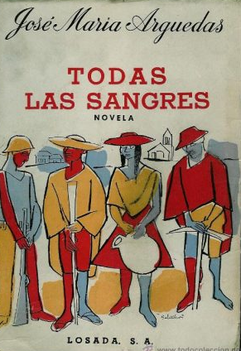
TODAS LAS SANGRES
Published in 1964, the novel describes the dispute between two brothers and landowners over the modernization of an Andean region.
The book was strongly criticized by the most prominent intellectual of the Instituto de Estudios Peruanos. The critics concerned the character of Demetrio Rendón Willka as it:
contradicted the predominant theology of mestizaje.
proposed an indigenous leadership in the political sphere.
Conclusion: political project proposed, not only unfeasable, but a potential harm for the country, and scientific rejection of the concept of “lo Andino”.

Slide 8
Indigenous Politics and the End of Mestizaje: Interculturalidad or Knowledge as Dialogic Relationship

Slide 9
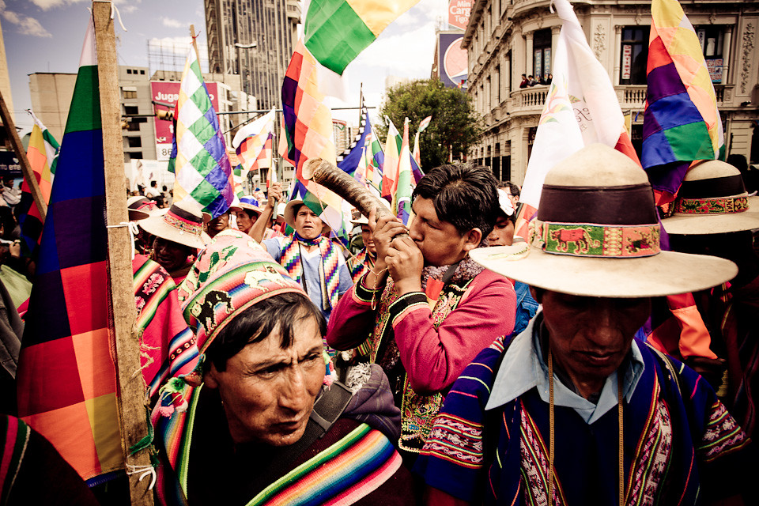
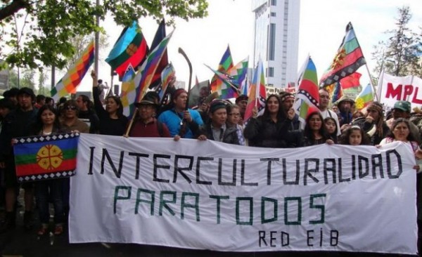
Interculturalidad
“Interculturlidad” promotes diversity through the acceptance of the co-existence between what is considered rational-knowledge and non-rational knowledge.
1970s Emergence of indigenous social movements claiming for the recognition and inclusion od their cultural-ethnic diversity in the political sphere.
“Interculturalidad” as an ambitious political project that aims at forging nations characterized by “pacific cohabitation among peoples and cultures, based on justice and equality for all”.
Political mobilization as an “uprising of knowledges” which led to the process of re-writing indigenous histories.
Organization and creation of an indigenous intellectual network that claimed for the creation of a political community characterized by ethnic and cultural diversity.

Slide 10
conclusion
Interculturalidad challenge is to create a new social relationship that can produce a democratic State that «does not hold cultural renunciation as a condition of citizenship.» (Marisol de la Cadena)
Anthropology has the potential to the adventure of a non-hegemonic and non-hierarchical knowledge.
Anthropological knowledge as a dialogical process of translation between the local and the universal.

Slide 11
Thank you for your attention

