Slide 1
Latin American and the U.S.A
Sofia Venturoli
2022/23
Latin America and the Us

Slide 2
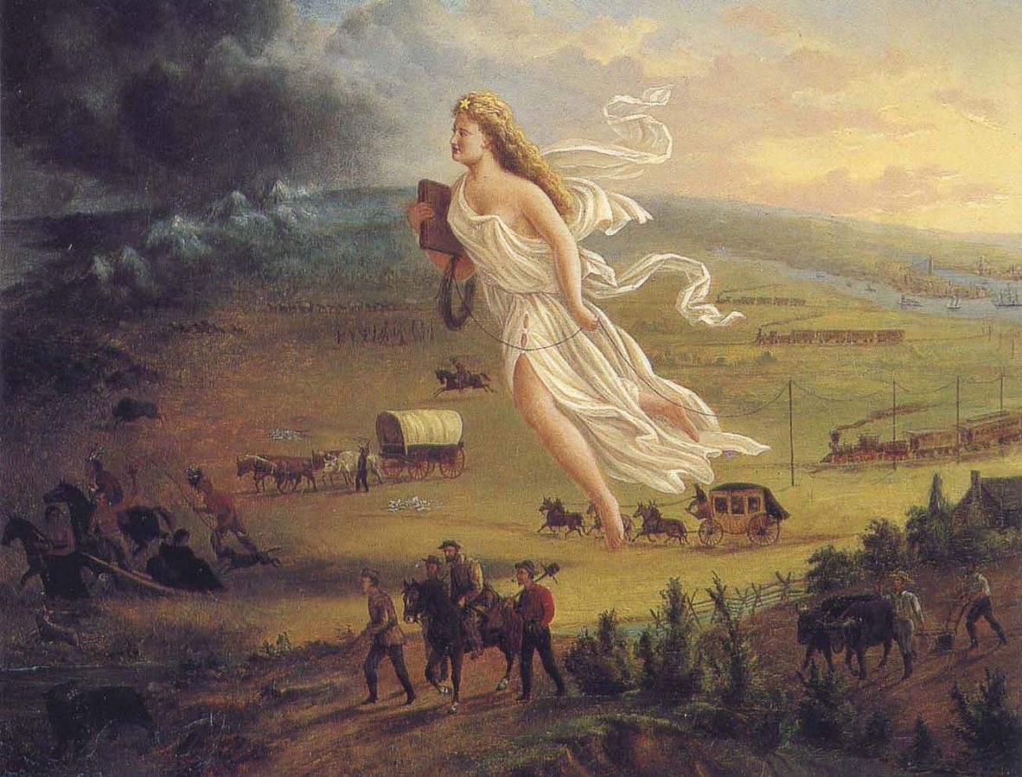
Manifest Destiny and the
Monroe doctrine
Nome del corso
Latin American Studies
Sofia Venturoli

Slide 3
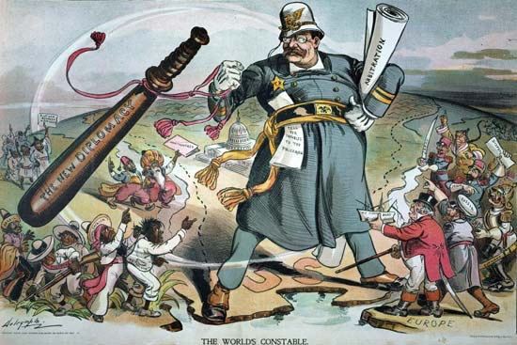
Nome del corso
“speak softly and carry a big stick”
The Monroe Doctrine (1823) and Theodore Roosvelt's Corollary (1904): the US as an international police, collective security and cooperation between American countries, US interference in Latin America and the Caribbean.
Latin American Studies
Sofia Venturoli

Slide 4
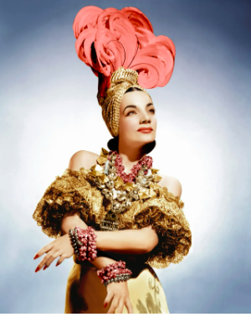
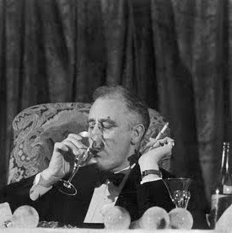
Good Neighbor Policy
Nome del corso
F. D. Roosevelt the "good neighborhood policy", the 1933 Treaty of Montevideo (Ralph L. Beals, 1969)
formal renunciation of the right of intervention in favour of peaceful
Saludos Amigos
Latin American Studies
Sofia Venturoli

Slide 5
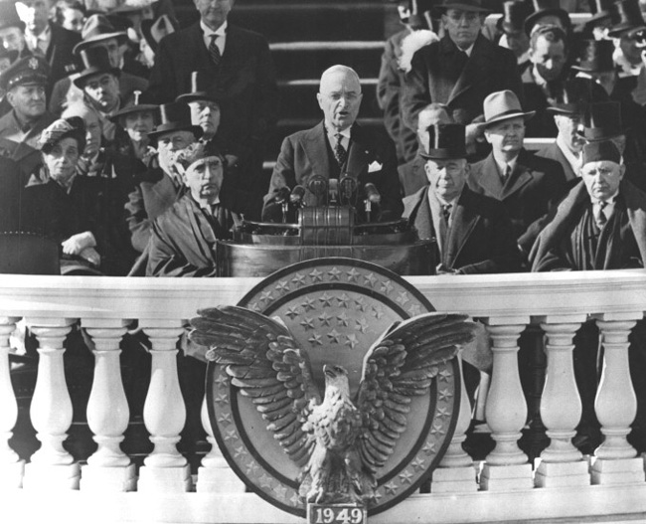
Nome del corso
1949 Inauguration Speech of Harry Truman
«Fourth, we must embark on a bold new program for making the benefits of our scientific advances and industrial progress available for the improvement and growth of underdeveloped areas.
The United States is pre-eminent among nations in the development of industrial and scientific techniques».
Latin American Studies
Sofia Venturoli

Slide 6
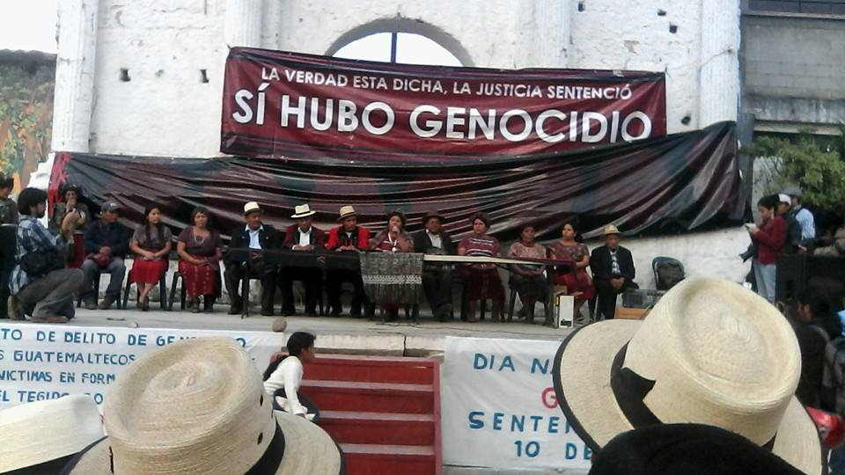
From Guatemala
onwards
Nome del corso
Latin American Studies
Sofia Venturoli

Slide 7
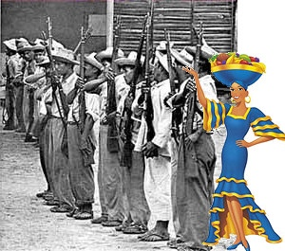
"En Honduras es más barato comprar un diputado que una mula"
Nome del corso
Support for dictatorships against land reforms
The coup in Guatemala 1954
The Cuban revolution 1959
Alliance for Progress and the Cuban invasion, embargo and Missiles crisis 1961-62
Coup in Chile 1973
Contras in Nicaragua 1979
Latin American Studies
Sofia Venturoli

Slide 8
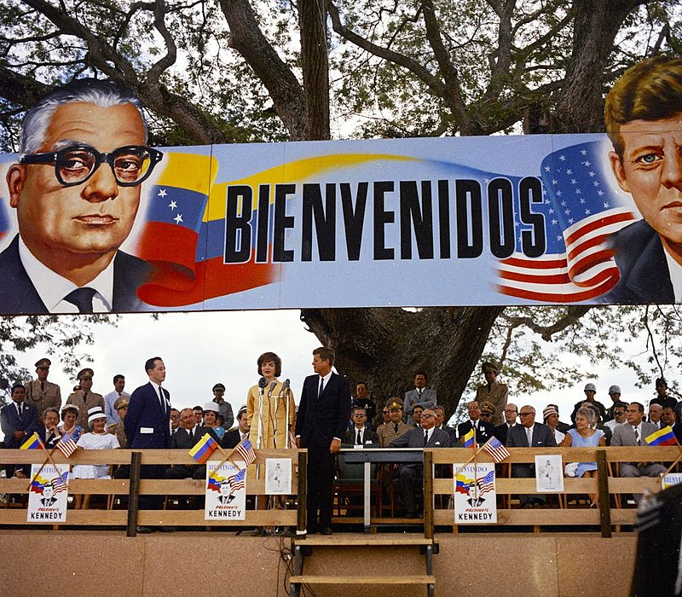
..we propose to complete the revolution of the Americas, to build a hemisphere where all men can hope for a suitable standard of living and all can live out their lives in dignity and in freedom. To achieve this goal political freedom must accompany material progress...Let us once again transform the American Continent into a vast crucible of revolutionary ideas and efforts, a tribute to the power of the creative energies of free men and women, an example to all the world that liberty and progress walk hand in hand. Let us once again awaken our American revolution until it guides the struggles of people everywhere-not with an imperialism of force or fear but the rule of courage and freedom and hope for the future of man. (Kennedy 1961)
Nome del corso
Latin American Studies
Sofia Venturoli

Slide 9
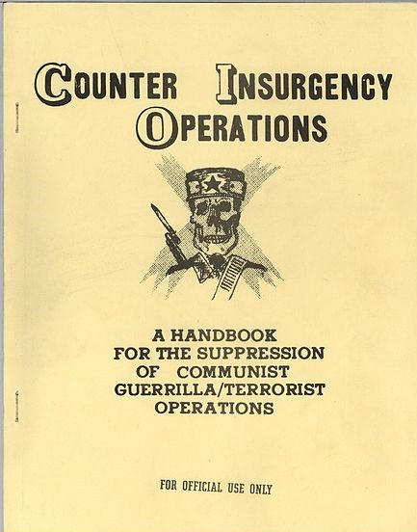
School Of Americas
Nome del corso
“The School of the Americas is a U.S. Army center for Latin American militaries that, since its establishment in the Panama Canal Zone in 1946, has trained over sixty thousand soldiers in combat-related skills and counterinsurgency doctrine”. (Gill 2004)
“Approximately forty-eight thousand soldiers and law enforcement officials from around the world in the United States in 2000, and between 1998 and 2000, ten thousand to fifteen thousand Latin Americans received instruction from U.S. military personnel in the United States and in their home countries” (Lumpee 2002).
“This is important because, according to numerous truth commission reports from the 1980s and 1990s, state security forces were responsible for the vast majority of massacres, murders, disappearances, and extrajudicial executions that characterized the twentieth-century Latin American ‘‘dirty wars,’’ when many countries su√ered under the boot of military dictatorships (remhi 1999; ancd 1986; cnpdh 1994; Comisión de la Verdad 1993), and that continue to plague Andean countries like Colombia” (Gill, 2004).
Latin American Studies
Sofia Venturoli

Slide 10
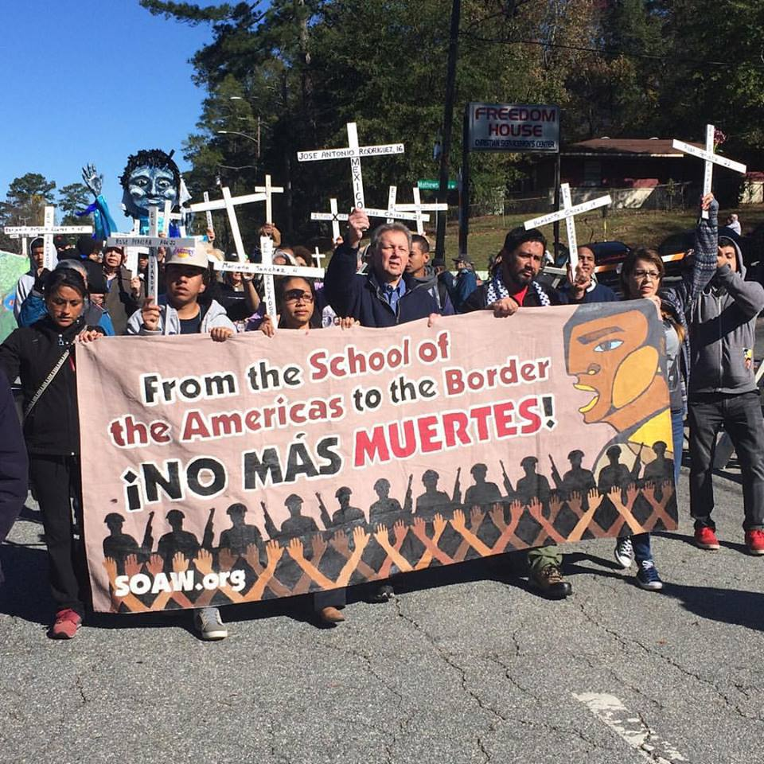
Political and
social violence
Nome del corso
Political and social violence
Unequal social orders
Race and Gender based violence
Impunity
State of fear: destruction of social cohesion (unions, cooperatives, grassroots organization
Latin American Studies
Sofia Venturoli

Slide 11
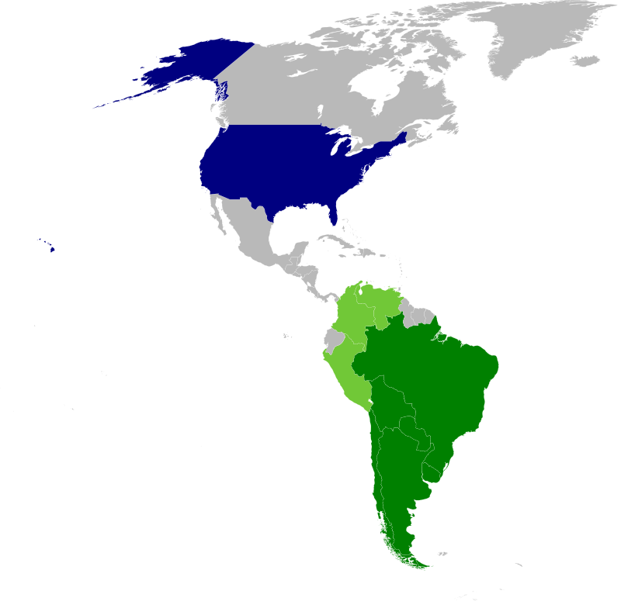
Green: Main active members (Argentina, Bolivia, Brazil, Chile, Paraguay and Uruguay) Light green: Sporadic members (Colombia, Peru and Venezuela) Blue: Collaborator and financier (United States)
Nome del corso
Operation Condor
Latin American Studies
Sofia Venturoli

Slide 12
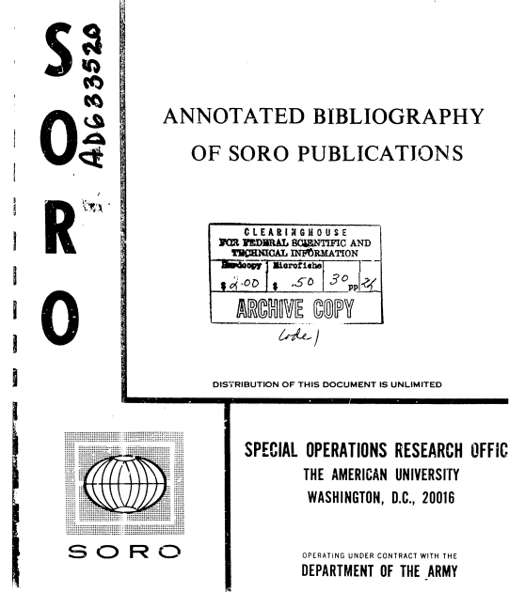
Nome del corso
SORO
Based on recent scholarly contributions and his own extensive work on this topic, Christopher Simpson has concluded that ‘military, intelligence, and propaganda agencies provided by far the largest part of the funds for large research projects in the social sciences in the United States from World War II until well into the 1960s’. (Solovay 2001)
“Winning the Cold War: The U.S. Ideological Offensive.”
Latin American Studies
Sofia Venturoli

Slide 13
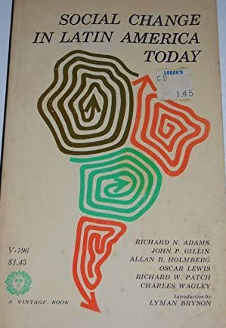
Modernization Theory
Nome del corso
Center for International Studies (CENIS) at MIT: CIA, Ford Foundation and Carnegie
The production of an alternative to Marxism
within the ICA, anthropologists in Bolivia and southern Peru were, […] more than coincidentally, utilized in areas where there were thought to be serious problems of communist agitation. (Adams 1964: 2)
“… the social organization of a peasant society is ill-adapted to the achievement of [the] high technological proficiency" on which modernization was presumed to depend (Notestein 1953, 26) […]
Moderate agrarian change, it was therefore argued, had to be guided by outsiders, working within the framework of"community development" to change (that is, westernize) "traditional" attitudes and values. […] (Ross, 2005)
"it was feared that rapidly increasing population pressure in relation to food supplies in South and Southeast Asia would result in the developing countries falling into the Communist camp" (Chandler 1992, 5). Eventually, the U.S. government and Ford would provide more than $100 million for such programs during the course oflndia's First and Sec- ond Plans in the 1950s (Brown 1971, 4), and U.S. anthropologists would play an important role in many of these programs » (Ross, 2005).
Latin American Studies
Sofia Venturoli

Slide 14
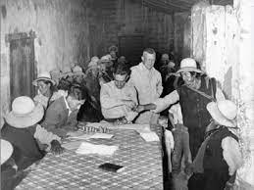
Project Vicos
Nome del corso
The “Controlled Change”: "an Indian farm (Vicos) where the natives can be studied under aboriginal conditions."
The establishing of the Society for Applied Anthropology In 1941.
Its real value, during the Cold War, was that it offered a seemingly benign way to counter opposition to Third World incorporation into the Western capitalist system.
In this problematical and contentious political climate, Holmberg's ostensible aim was, nevertheless, to develop Vicos as a model whose "anticipated results," according to William Mangin, could be "diffused throughout Peru and the world" (1979, 67). Once again, he betrayed a superficial grasp of Andean realities that was congenial to the imperatives of contemporary U.S. policy. (Ross, 2005)
…
Latin American Studies
Sofia Venturoli

Slide 15
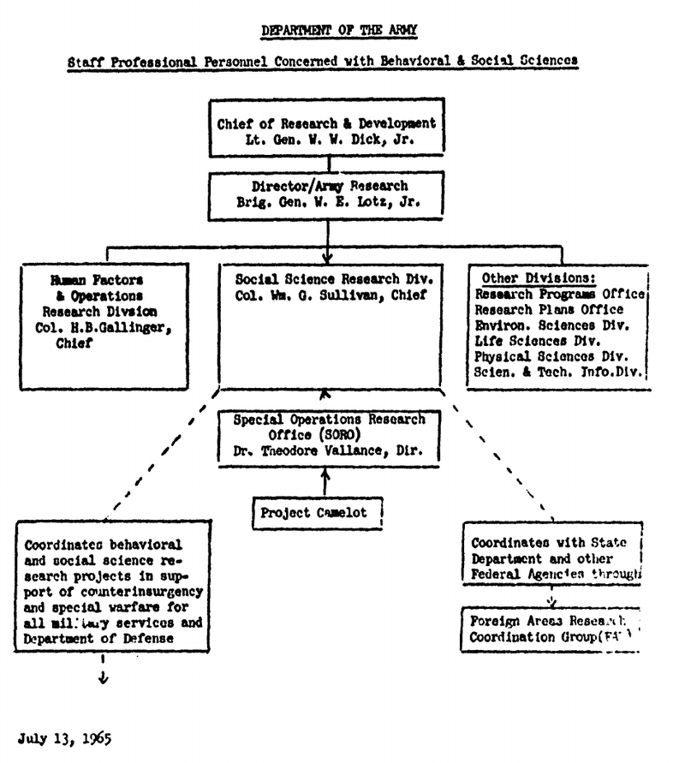
Nome del corso
Project Camelot
The influence of political decisions and climates on social research is not new, but the fact that this can no longer be ignored is. Camelot, a proposed international social science research project sponsored by the Army Research Office of the United States Department of Defense, was the turning point. (Ralph L. Beals, 1969)
Based on recent scholarly contributions and his own extensive work on this topic, Christopher Simpson has concluded that ‘military, intelligence, and propaganda agencies provided by far the largest part of the funds for large research projects in the social sciences in the United States from World War II until well into the 1960s’. (Solovay 2001)
Latin American Studies
Sofia Venturoli

