Slide 3
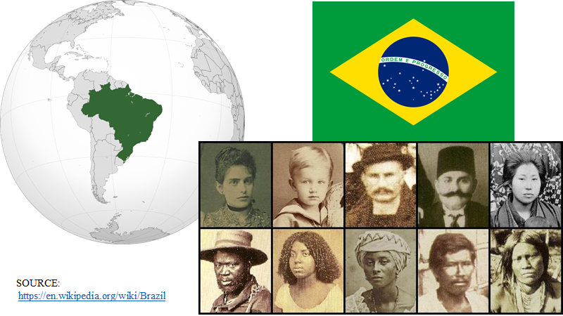

Slide 4
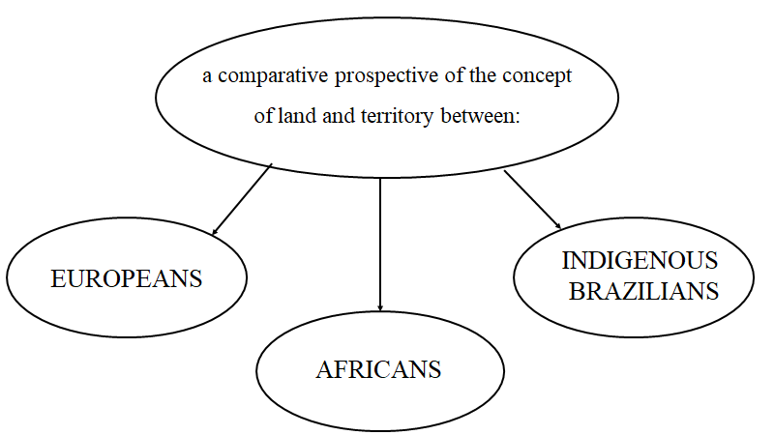

Slide 9
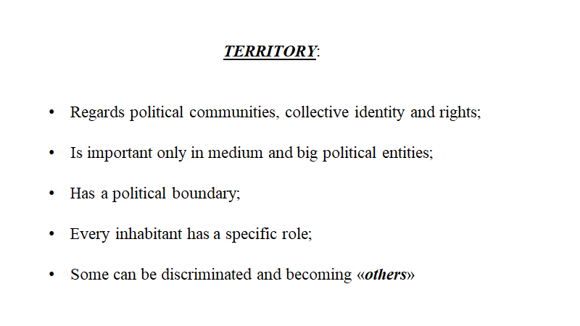

Slide 10
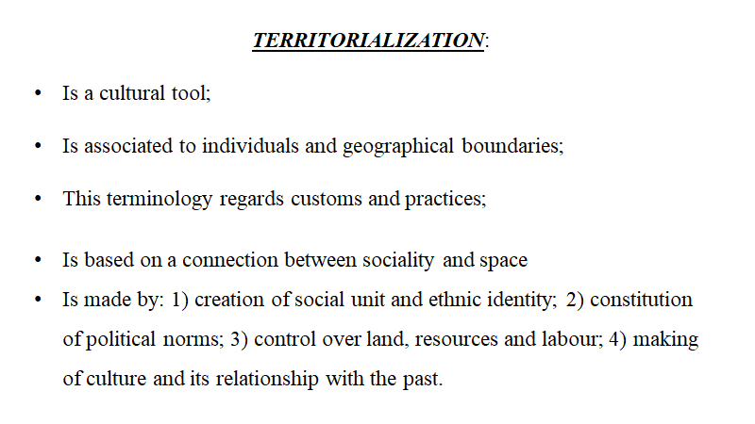

Slide 11
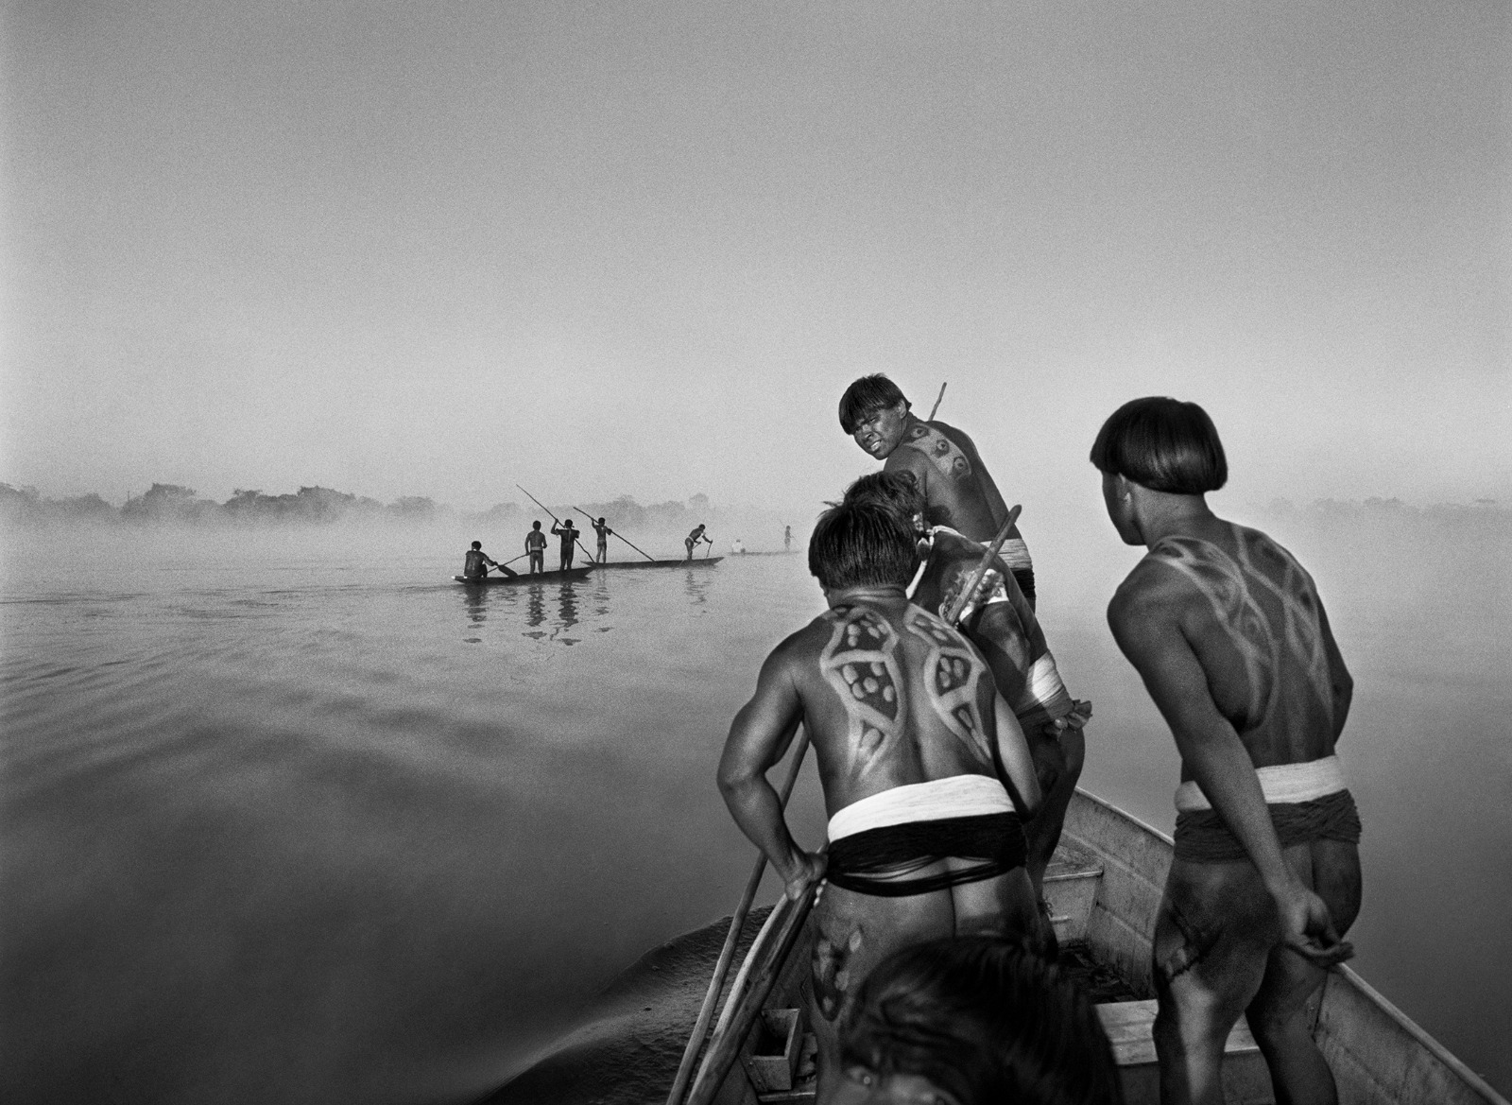
Indigenous territory in Brazil
Role of the anthropologist: take part in the project of indigenous territoriality → report and map of delimitation
Role of the state and private actors: confrontation and sometimes clash between different political project of indigenous and other actor’s interests
Role of indigenous peoples: pressure on FUNAI and seek allies in public opinion
At legal condition: indigenous lands are under the dominion of the Union → indigenous condition is that of paesentry whose existence is under a tutelary regime

Slide 12
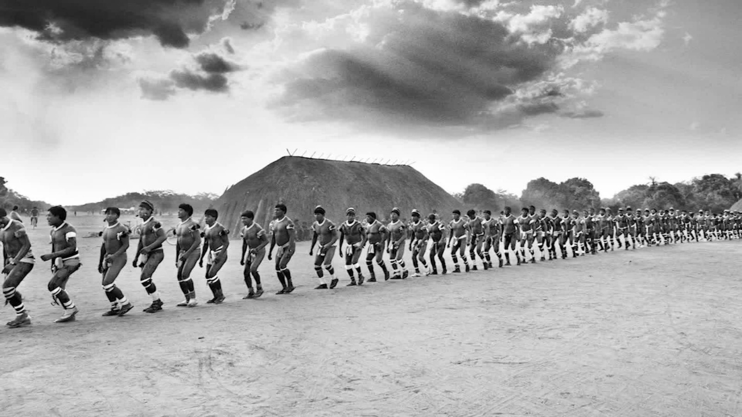
Hypothesis developed in the dossier
Evidently there is a huge gap between right established by the state and its materialisation in diverse political contexts
The struggle of indigenous peoples or communities for acquisition and recognition of a territory → key point: to understand the meaning of transformations in which they’re involved as subjects

Slide 13
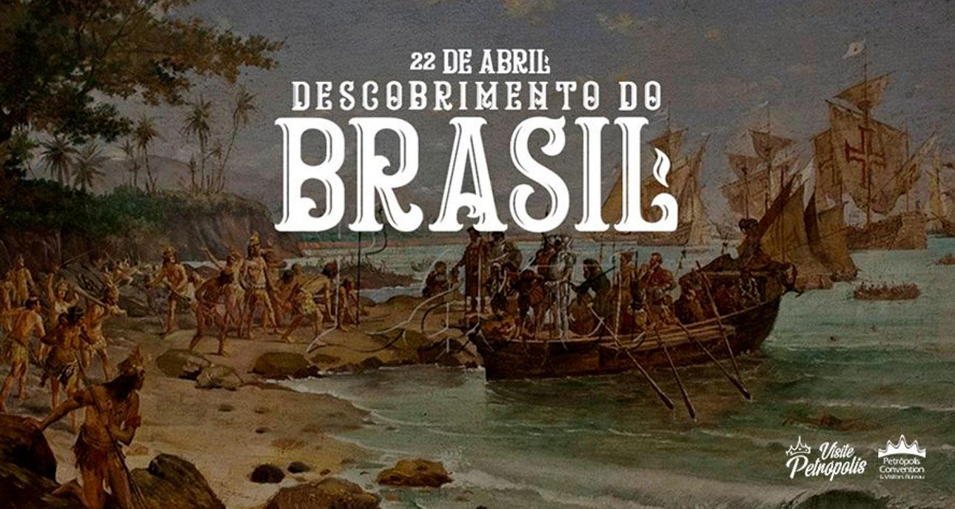
The different forms of territorialisation in the colonial...
First form of territorialisation:
discovered of lands now know as Brasil (1500)
no antagonism and creation of only commercial warehouses and small hamlets
natives suffered only limited impacts from this meeting
Second form of territorialisation:
foundation of the city of Salvador (1549)
start the process of colonisation carried on with weapons
crusade for catechisation → self legitimation at a religious level → born the mission lands
imagine of indios connected to primitiveness → transformation in useful and loyal subjects

Slide 14
...and postcolonial history of Brazil
Third form of territorialisation:
Independence of Brazil (1822)
policy of incorporation and aesthetic and moral revaluation → no favourable effects on indigenous life condition: in more distant regione they remain under the missionare tutelage / in areas of earlier colonisation they were considered mesticos and second-class citizens
indios were reduced to landless peasants, discriminated for their ancestry and limitated in the exercise of their traditions
Fourth form od territorialisation:
Creation of the Indian Protection Service (SPI) (1910)
official policy of protection and tutelage → tutelage passed under control of national army (Comte positivism)
unofficial extermination practices → “brave indians” vs private economic agents
pax colonial: based on sedentarisation of indegenous and tutelage of indigenist agency

Slide 15
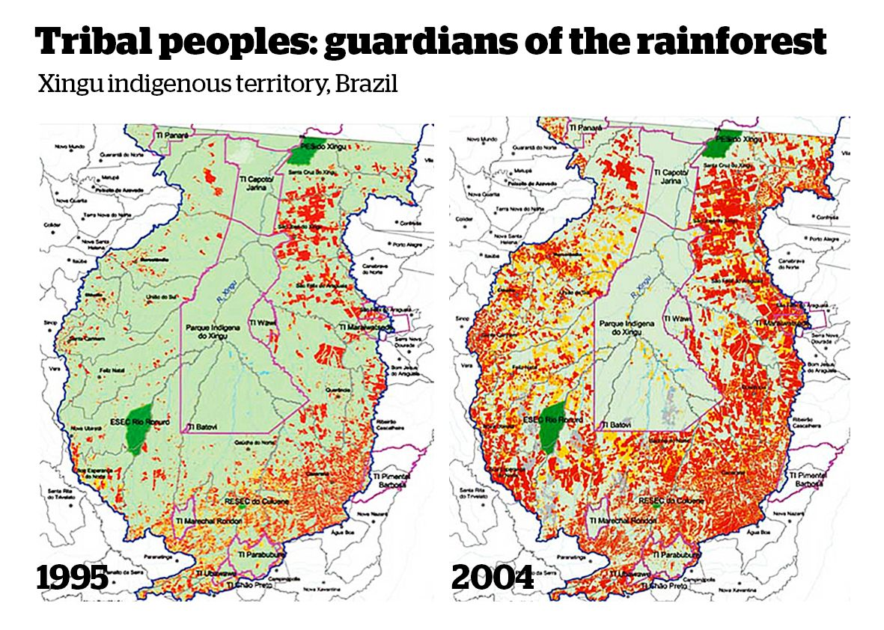
Fifth form of territorialisation: formation of indigenous territories
Born the Xingu Indigenous Park in 1961: inspired by policy of reserves in U.S.A. and indigenous in Mexico → indigenous lands meet the socio-cultural needs of each people or community
SPI existence and precarious regularisation of lands → in 1967 Relatòrio Figueiredo
The new constitutional text of 1988 imposed the definition of the indigenous lands on the base of traditional occupation

Slide 22
