Slide 1
Association Between Average Daily Steps and Preterm Birth Risk
A Multicenter Cohort Study

Slide 2
Background
It is known that physical activity during pregnancy reduces adverse peri-natal outcomes, such as pre-term birth.
Forty-one studies (43 publications) including 20 randomized trials and 21 cohort studies were included.
Physically active compared with inactive women have an 10-14% reduction in the risk of preterm birth.
Daily step count has emerged as a convenient and objective measure of physical activity to health outcomes
Limited studies have specifically examined the association between average daily steps and preterm birth risk.
Aune D et al.: a systematic review and meta-analysis of epidemiological studies. BJOG. 2017 Nov;124(12):1816-1826. doi: 10.1111/1471-0528.14672. Epub 2017 May 30. PMID: 28374930.
Paluch AE et al.; Steps for Health Collaborative. Daily steps and all-cause mortality: a meta-analysis of 15 international cohorts. Lancet Public Health. 2022 Mar;7(3):e219-e228. doi: 10.1016/S2468-2667(21)00302-9. PMID: 35247352; PMCID: PMC9289978.

Slide 3
Aim
To assess the impact of daily steps during pregnancy on the risk of preterm births.

Slide 4
Methods (STROBE Statement)
Study design
Multicentric cohort study: 18 centres all over Italy
Accrual duration: From Sep 2024 to Sep 2026
Setting
Recruitment: First ultrasound during the first trimester of pregnancy
Participants
Pregnant women ≥ 18y
Excluding
Athletes
Physical disabilities
Pregnancies at risk
Twins
Previous C-cut
Language

Slide 5
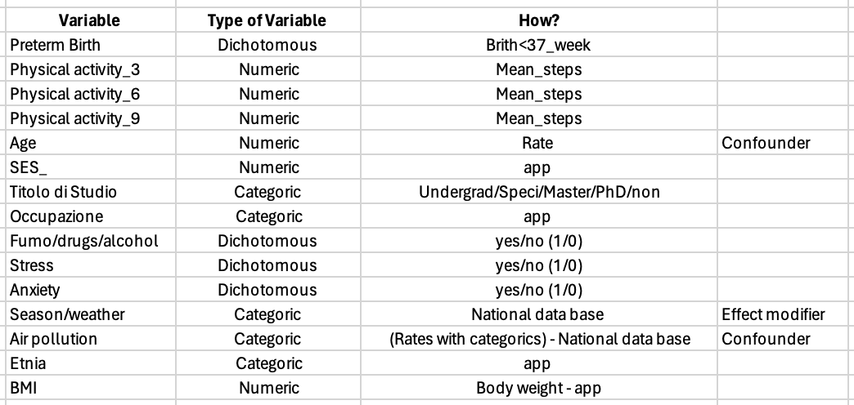
Methods (STROBE Statement)
Variables
Outcome: preterm birth defined as deliver before 37 w
Exposure: average daily steps during pregnancy
5,000 steps (dichotomous variable)
Effect modifiers: season
Potential confounders
Other physical activity
Maternal age
BMI
SES (Equivalized Household Income Indicator)
Air pollution
Stress
Maternal education
Occupation
Smoke and alcohol consumption

Slide 6
Methods (STROBE Statement)
Data sources/measurement
Mobile app
Steps count
Questionnaires
Time of recruitment
Second trimester – first notification
After birth – second notification (42 weeks after conception)

Slide 7
Methods (STROBE Statement)
Bias
Selection: Access to technology
Follow up: to lose sample after the 2nd trimester
Information: Self report (No control)

Slide 8
Methods (STROBE Statement)
Study size
Sample size calculator
Should be high due to the numerous confounding variables that need to be addressed
Statistical method
Multivariable analysis

Slide 9
Limitations
Limited generalizability of the study (only healthy women)
Limited sample size due to short duration of recruitment
High level of confounding
Method’s accuracy (smartphones app)

Slide 10
Grazie per l’attenzione
Akberi Afkhami Hirad
Bazzurro Francesca
Fallara Davide
Frattin Roberta
Giraldo Margarita
Mennea Lucia Mir
Montini Chiara
Novaro Andrea
Romagnuolo Flora
Rousset Stefano
Trapletti Valentina

