Slide 1
Labour market, health and well-being: economic analysis using panel data
Silvia Mendolia

Slide 2
My areas of research: Labour, Health and Education Economics silvia.mendolia@unito.it Office: 5th floor Consultation times: TBA Please email me to make an appointment!
Silvia Mendolia

Slide 3
What is this class about?
Brief introduction to Stata
How to use Stata to analyse Panel Data
Use of panel data in applied microeconomics
Empirical questions related to health and labour economics that can be analysed with panel data

Slide 4
Useful background textbooks
Wooldridge, J.M. (2002), Econometric Analysis of Cross Section and Panel Data. MIT Press: Cambridge, MA
Angrist, J. , Pischke (2009), J Mostly Harmless Econometrics (https://www.mostlyharmlesseconometrics.com/)

Slide 5
Recent Nobel Prize in Economics
David Card, Joshua Angrist, and Guido Imbens have shown that natural experiments can be used to answer central questions for society, such as how minimum wages and immigration affect the labour market.
https://www.nobelprize.org/prizes/economic-sciences/2021/popular-information/

Slide 6
Recent Nobel Prize in Economics
Abhijit Banerjee, Esther Duflo and Michael Kremer “for their experimental approach to alleviating global poverty”
https://www.nobelprize.org/prizes/economic-sciences/2019/press-release/

Slide 7
Assessments for this class
In-class presentation of empirical paper and discussion (35% of final grade)
Presentations in week 5, 6 or 7 (13/3; 20/3 or 3/4)
Mini-research project (in groups) using teaching datasets available on Moodle. We will have time to plan and discuss the project in class together (65% of final grade)
Presentations in week 7 or 8 (3/4 or 10/4)
Paper handed in at exam dates

Slide 8
Assessments for this class
In-class presentation of empirical paper and discussion (35% of final grade)
You will choose an empirical paper in the area of labour/health economics among a set of readings available on Moodle
You will have 15 minutes to present it in class and answer questions on it
You can work alone or in a group (3-4 people)
Your presentation should focus on: Motivation of the work, data utilised, methodology, main results and policy implications
Week 5, 6 or 7 (3 groups each week)

Slide 9
Assessments for this class
Mini-research project using teaching datasets available on Moodle. We will have time to plan and discuss the project in class together (65% of final grade)
You can work alone or in a group (5 people)
You will use a longitudinal dataset to answer your own research question
You will prepare a 15-20 minutes presentation of your research to the class, presenting your research question, relevant literature, data and methods, and main findings
Week 7 or 8

Slide 10
Assessments for this class
You will write a mini-research paper based on your research project (around 3,000 words)
You will hand this in at your preferred “appello”
As always, there will be several “exam” dates for you to choose when to hand in your paper (May, June, July)

Slide 11
Presentations
Presentations will be an opportunity for us as a class to show ideas, and discuss research topics in a friendly and relaxed environment
Try to make your presentation engaging and fun to watch!
Practice your presentations in front of friends and in your group
Engage your audience with games, questions, etc!

Slide 12
Attendance for this class
Attendance (in person or online) is highly recommended, given the nature of the class
Students who cannot attend the class will sit a 2-hours written exam based on readings and lecture notes

Slide 13
Lecture Structure
Each week we will discuss some theoretical and applied topic related to panel data analysis and its applications in applied microeconomics
In the first part of the lecture, I will present the topics and examples and will give you some applied questions/example to solve
In the second part of the class, you will be working on the computers preparing your assignments (presentations and research project) with my support

Slide 14
Our schedule
Topics | Week
Introduction. Presentation of this lab. What is Stata and how to use its basic functions | 1 – 14/2
Describing your data using Stata | 2 – 21/2
Cross Section and Panel Data The structure of Panel Data How to use Stata to construct a longitudinal data set | 3 – 28/2
Linear Panel Regression Problems with Pooled OLS and possible solutions with panel data Fixed effects model | 4 – 6/3

Slide 15
Our schedule
Topics | Week
Random effects model Tests and Diagnostics Correlated Random Effects Limitations of Panel Data Group presentations on empirical paper | 5 – 13/3
Empirical example 1 – Individual Fixed Effects (incl. presentations) Group presentations on empirical paper | 6 – 20/3
No class on 27/3 (Easter break)
Empirical example 2 – School Fixed effects (incl. presentations) Group presentations on empirical paper | 7 – 3/4
Final work on research project Group presentations on research project | 8 – 10/4
LECTURES END 10/4

Slide 16
Any questions on the assessments?

Slide 17
What is Stata?
Stata is a computer program which provides a very flexible computer environment in which one can conduct various analysis of data
Stata is a full-featured statistical programming language for Windows, Macintosh, Unix and Linux
It can be considered a “stat package,” like SAS, SPSS, RATS, or eViews
The number of variables is limited to 2,047 in standard (Intercooled) Stata
Stata/SE and Stata/MP can fit models with more independent variables than Stata/IC (up to 10,998).
The number of observations is limited only by memory

Slide 18
Strengths of Stata
Stata is a command-driven statistical package for statistical analyses, data management and graphic presentations
Stata is designed for researchers in the fields of econometrics, social science and biostatistics
In particular, Stata allows you to do the following statistical analysis:
Panel and Survey Data Analysis
Discrete and Limited Dependent Variable Analysis
Maximum Likelihood Estimation
Regression Analysis and Regression Diagnostics
Data Management and Transformation
The capabilities of Stata are not limited to the features above. Stata codes can be shared, reused and made into extensions for specialized routines

Slide 19
Strengths of Stata
Stata has 3 major strengths:
Data manipulation: moving data from external sources into the program, cleaning it up, generating new variables, generating summary data sets, merging data sets, reshaping data sets from “long” to “wide”
Statistics: Stata provides all of the standard descriptive statistics and t-tests through most sophisticated regressions. This includes regression diagnostics, prediction, robust estimation of standard errors, instrumental variables and two-stage least squares, seemingly unrelated regressions, vector autoregressions and error correction models, logit, probit, ordered logit and probit, multinomial logit etc.
Graphics: These are excellent tools for exploratory data analysis, and can produce high-quality graphics in many different forms. Every aspect of graphics may be programmed and customized

Slide 20
Updating Stata
One of Stata’s great strengths is that it can be updated over the Internet
Updates during the life of the version you own are free
You need only have a licensed copy of Stata and access to the Internet to check for and, if desired, download the updates
Use ssc install…. To install user-written commands

Slide 21
Launch Stata
Double click on the program icon on your desktop
or
Go to the Start menu/Programs/Stata
or
Click on a Stata dataset icon
You will end Stata by typing exit in the command window

Slide 22
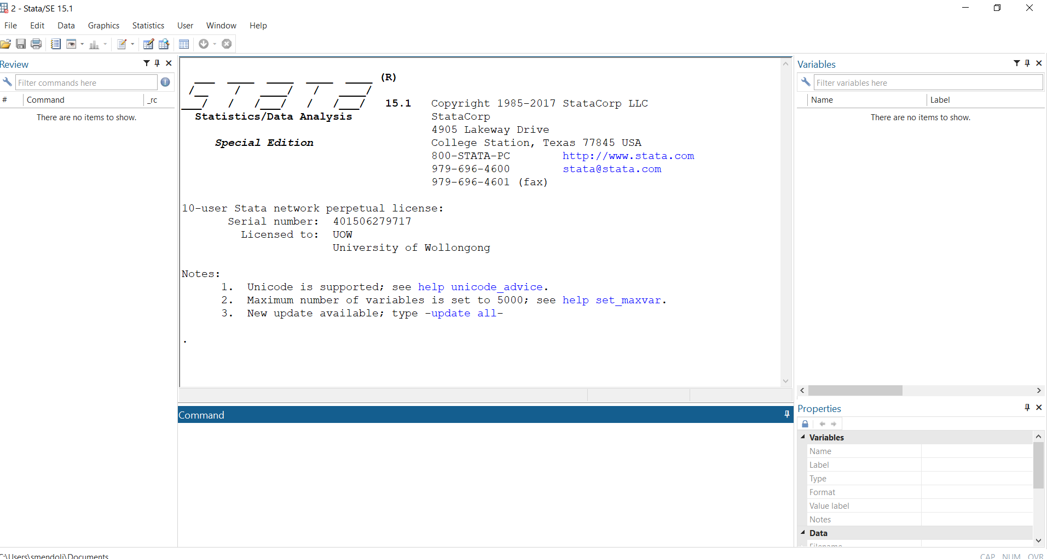
Stata windows and Interface
Output window
Variable window
Review window
Command window
Notes:
Past command appear in the review window
Working directory is shown in the grey bottom bar
Variables are listed in the variable window
Review Window
All the commands you have entered for the current session are listed in this
window. You can recall the previous command by clicking on the line in the
window You can also scroll the commands you issued with Page Up or Page
Down on the keyboard).
Variable Window
Lists all the variables contained in the dataset (in this example, we have not
imported any datasets yet, so the variable list is empty).
Output Window
Any results or messages from Stata will be shown in this window.
Command Window
Any Stata commands can be issued here.

Slide 23
Stata Toolbar
Log
Save dataset
Do file
Data browser
Break
Open
Print
Viewer
Variable manager
Graph
Data editor
More
Notes:
open: open a stata dataset.
save: save a dataset.
print: print contents of active window.
log: to start or stop, pause or resume a log file.
viewer: open viewer window, or bring to the front
results: open results window, or bring to the front.
graph: open graph window, or bring to the front.
do-file editor: open do-file editor, or bring window to the front.
data editor: open data editor, or bring window to the front.
data browser: open data browser, or bring window to the front.
more: command to continue when paused in long output.
break: stop the current task. This command returns the system to as it was before you issued the command.
The data editor allows you to change the data values or the variable properties; on the other hand,
you can only browse the data set with the data browser.

Slide 24
Stata Menus and dialogs
Stata is a command driven application
You can also access most of the commands by selecting items from Stata’s menus to open dialogs that build Stata command
Stata’s Data, Graphics and Statistics menus provide point and click access to almost every command in Stata
The User menu provides a place for programmers to add their own menu items

Slide 25
Where to find help (1/2)
The manuals are useful, particularly the User’s Guide and Getting Started with Stata
You can join StataList and take profit from the more informal support provided by other users
The command findit keyword can also be used to locate Stata materials, including descriptions of built-in commands, Stata FAQs, and hundreds of user-written routines
Useful links:
https://dss.princeton.edu/training/
http://www.stata.com/support/
http://www.stata.com/links/resources.html
UCLA STATA reference page: https://stats.idre.ucla.edu/stata/modules/

Slide 26
Where to find help (2/2)
Command | Description
Help stata command | Display the description and the syntax of the Stata command (when you already know the name of the command)
Lookup topic | Display information on the requested concepts, including useful commands and FAQ
Search topic | Find the Stata command you are looking for (when you don’t know the specific name)

Slide 27
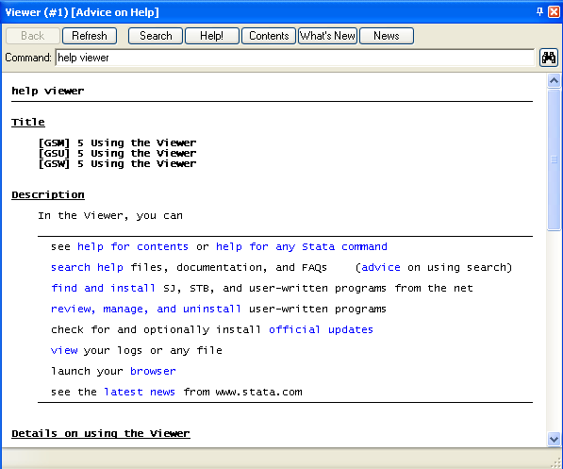
Stata Viewer
The Viewer is where you can see help information, view or print log, check and install the latest official updates to Stata. You can Open it from the main Stata menu: Window - Viewer
Advice: how to use the Viewer
Contents: table of content for Stata help files
What’s New/News: new features of Stata

Slide 28
Simple rules in Stata
Variable names cannot be longer 32 characters
Use letters, digits and/or the underscore for a variable name
It is preferable for a variable to start with a letter
Stata is case-sensitive. For instance, A and a are considered as two different variable names. However, most Stata commands are in lowercase

Slide 29
Files extension in Stata
You will work with 3 kinds of files:
Do file (or program file): filename.do
Do files allow to save your commands and to keep track of what you have been doing. It is essential that you write comments on your program, so that you know what the last modifications were
Log file: filename.scml or filename.log (text file)
The Stata log file records the commands you entered and the corresponding output for the current session
Data set: filename.dta

Slide 30
Reproducibility
Keeping track of your work using a do file is very important in order to be able to reproduce your research
If you are conducting scientific research you must be able to reproduce your results
Ideally, anyone with your programs and data should be able to do so without your assistance
Reproducibility also makes it very easy to perform an alternate analysis of a particular model
What would happen if we added this interaction, or introduced this additional variable, or decided to handle zero values as missing?

Slide 31
Getting started with Stata
Open a do file
Start every do file with an indication of your working directory
The working directory displayed at the bottom left hand corner of the main window is your default directory. Any files you save without specifying a directory will be saved here
You may change the working directory entering: cd ”directoryname”
Set memory, if necessary, by using the command set mem # (e.g set mem 100m)
Notes:
where # is a number greater than the size of the dataset, and less than the total amount of memory available on your system.
To check the amount of memory (RAM) your system has available, go to the Start menu and click on \Settings\Control Panel\System. The bottom line, under General tells you how many KB of RAM you have available.
STATA opens with a default memory of 1mb.

Slide 32
Stata Do file
To open a do file click on the envelope icon on the main toolbar
The first icons are standard Window icons
You can run one single line by clicking on
Write comments starting with * or /*
Notes:
Before we start I would like you to download the relevant material from the course web page.
Please go on the course web page/Course Material/Stata Material and dowload the three files on your computer (2 data sets and 1 excel)

Slide 33
Stata log file
The Stata log file records the commands you entered and the corresponding outputs for the current session
The log file itself is in plain text format. You can open it with any word processor like Microsoft Word or Notepad
Keep in mind that you need to close a log file when you want to stop recording the Stata output. You can do this typing log close
To open a log file, you can either use the open log button, or enter the Stata command in the command window log using c:directory\filename.log
You can temporarily close a log file typing log off and then starting it again typing log on
The command log using c:directory\filename.log, replace overwrites a log file on an existing one

Slide 34
Read other files in Stata (1/2)
Stata can read practically all types of data files. There are commercial softwares (StatTransfer) which translates data created from other softwares into Stata form and vice versa
Two common file formats for raw data are comma separated files and tab separated files. Such files are commonly made from spreadsheet programs like Excel
Clear the memory before starting typing clear
If the first line has the names of the variables, separated by commas or tabs, type insheet using filename.raw
If the names of the variables are not specified, type insheet var1 var2 var3 var4 using filename.raw
Notes:
Launch Excel and read your excel file
Save as a text file (tab delimited or comma delimited) choosing file save as
Save then file under filename.txt or filename.csv
Quit Excel
Use the insheet command in Stata
A single cell containing a nonnumeric character, such as a letter, within a column of data is enough for Stata to make that variable a string variable. It is often easiest to fix this within Excel.
Insheet cannot read files separated by a mixture of commas and tabs.
If non file extension is specified, .raw is assumed
Before inputting new data, remember to type clear
Suppose you have 4 variables

Slide 35
Read other files in Stata (2/2)
Now consider a file where data are separated by spaces
You can read it by typing: infile var1 var2 var3 var4 using filename.raw
This command assumes that all variables take values that can be handled by float (8.5 digits accuracy)
If var2 is a character variable that takes less than 10 characters, you should type infile var1 str10 var2 var3 var4 using filename.raw
If var1 takes more than 7 digits, you should specify: infile double var1 var2 var3 var4 using filename.raw
Notes:
Observations need not be on a single line. The location of line breaks does not matter
Things that ate not understood (***) are mentioned and are stored as missing values

Slide 36
Common problems (1/2)
Spaces: what appear to be purely numeric data in Excel are often treated by Stata as string variables because they include spaces (or letters)
Cell formats: Much formatting within Excel interferes with Stata's ability to interpret the data reasonably. Make sure that all formatting is turned off, at least temporarily
Variables names: Stata limits variable names to 32 characters. Note also that your variable names should start with a letter
Notes:
Format: you can do this by selecting the entire spreadsheet, pulling down Format, then Cells, and selecting General as the format.

Slide 37
Common problems (2/2)
Missing rows or columns: Completely empty rows in a spreadsheet are ignored by Stata, but completely empty columns are not. A completely empty column gets read in as a variable with missing values for every observation
Missing observations: Make sure that every missing observation is replaced by an empty cell or a numeric value (eg. 999, -1…)

Slide 38
Open a Stata dataset
If you want to open a Stata dataset, enter the command: use filename.dta, clear or click on the window icon
In some cases you may get the message “no room to add more observations or no room to add more variables”. This is because not enough memory has been assigned to STATA
Change memory settings as explained above
To save a data file, enter the command: save, replace (overwrite the current file) or save filename, replace (to save the current file as filename)

Slide 39
Various ways to look at your data
Describe: If you are using a data set created by someone else, you may want to know what is in the data set.
Type describe using filename, to obtain basic content of the data file
Type describe to get a description of the data in memory
Summarize: This gives a summary statistics of all data in memory (number of observations, mean, st.dev, min, max)
summarize, detail gives more detailed summary statistics
summarize var1 gives summary statistics of var1
List: This command let you browse through the dataset.
list var1: list all observations in var 1
list in 3/8: list all variables of observation 3 through 8
list if condition: list all observations that satisfy the conditions
Notes:
You can abbreviate Stata commands or variable names with the Þrst two or three letters if they are not ambiguous to Stata.

Slide 40
Various ways to look at your data
Tabulate: this command is very useful to produce one and two way tables, including frequencies (single and cumulated) and percentages
Type tabulate var1 for one way tables for var1 or tabulate var1var2 for two way tables
Correlate: The correlate command displays the correlation matrix or covariance matrix for a group of variables or for the coefficients of the most recent estimation
If the variables are not specified, the matrix is displayed for all variables in the data
Notes:
You can abbreviate Stata commands or variable names with the Þrst two or three letters if they are not ambiguous to Stata.

Slide 41
Labelling datasets and variables
You can easily label variables using the command: label variable varname “labelname” (e.g. label variable nch “n_children”)
Use label data to set or reset the dataset’s label
To associate names with numbers, use label define coupled with label values
You can associate categories to labels: label define labelname # “label”, # “label (e.g. label define yesno 1 yes 2 no)
You can associate the value label with a variable: label value varname labelname (e.g. label value answer yesno)
Notes:
This is different from rename a variable:
rename old new
label variable attaches a label (up to 80 characters) to a variable. If
no label is specified, any existing variable label is removed.
label define defines a list of up to 65,536 (1,000 for Small Stata)
associations of integers and text called value labels. Value labels are
attached to variables by label values.
label values attaches a value label to a variable. If no value label is
specified, any existing value label is detached from that variable. The
value label, however, is not deleted. Value labels may be up to 32,000
characters long.
Use label list to list names and contents of value labels
label list [lblname [lblname ...

Slide 42
Some notation in Stata
Equal: ==
Not equal: != or ~=
Greater or equal: >=
Smaller or equal: <=
And: &
Or: |
Not: !
Notes:
.

Slide 43
Data Manipulation (1/2)
Generating new variables: The generate command is used to create a new variable. Generate can create a new variable that is an algebraic expression of other variables.
generate newvar = exp [where exp is an algebraic expression]
To change the contents of an existing variable you must use the replace command
replace oldvar = exp
Example: to create a new variable agerange from an existing variable age (from 0 to 45)
gen agerange = . if age<16 [where . is a missing value]
replace agerange=1 if 16<=age & age<25
replace agerange=2 if 25<= age & age<45
Notes:
You can abbreviate Stata commands or variable names with the Þrst two or three letters if they are not ambiguous to Stata.

Slide 44
Data Manipulation (2/2)
Example 2: to create a dummy variable age16 identifying all 16 year olds in the dataset
gen age16=0
replace age16=1 if age==16 [note the == for an existing value]
The egen command creates new variable equal to a function specifically written for egen
e.g.: egen avg=mean (var1)
Drop: this command drops the selected variables and/or observations
e.g.: to drop var1: drop var1
To drop all data in memory: drop _all
To drop observations 5 to 10: drop in 5/10
Keep: this command keeps only the specified variables and/or observations

Slide 45
Stata command syntax
The general syntax in Stata is:
[by varlist] command [varlis] [=exp][if exp] [in range] [,options]
the brackets denote additional elements
If a variable is not specified the command is applied to all variables
If and in allow to restrict the command to a specific subdataset
e.g.: in 5/10: observation from 5 to 10
e.g.: if var1>10; if var1!=.
The by prefix causes the command that follows to be repeated for each unique set of values of the variables in varlist
e.g.: by region: summarize population: this gives descriptive stats for the variable population, separately for each value of the variable region
Notes:
In order to use the by option data should be sorted. Use the comand sort region before using the by option

Slide 46
Manipulate data sets (1/3)
To unite two datasets, use the merge command
Merge joins corresponding observations from the dataset currently in memory (called the master dataset) with those from filename.dta (called the using dataset), matching on one or more key variables.
Merge can perform match merges (one-to-one, one-to-many, many-to-one, and many-to-many)
Merge is for adding new variables from a second dataset to existing observations. You use merge, for instance, when combining hospital patient and discharge datasets.
Notes:
Note that the first file is treated as a master file.
So, if you are merging two datasets containing the same variable for the same observation, the information from the first file is showed in the final dataset

Slide 47
Manipulate data sets (2/3)
If you wish to add new observations to existing variables, then see append.
You use append, for instance, when adding current discharges to past discharges.
By default, merge creates a new variable, _merge, containing numeric codes concerning the source and the contents of each observation in the merged dataset.
1: Master file only
2: Using file only
3: Both files
Notes:
Note that the first file is treated as a master file.
So, if you are merging two datasets containing the same variable for the same observation, the information from the first file is showed in the final dataset

Slide 48
Manipulate data sets (3/3)
You can append two datasets using the append command
The two datasets must contain the same variables
The append syntax is: append using filename
You may change the dataset format using reshape long and reshape wide command
E.g. reshape long var1 var2 i(var3) j(var4) where var3 is the ID variable and var4 is the N dimension
Notes:
Suppose you have labour force spells in rows
Man Spelln Spell status1 Sdate1 Edate1 Spelln Spstat2 Sdate2 Edate2
1 1 Empl 03/2000 05/2004 2 retired 06/200412/2006
And you want
Man Spelln Spell_status Sdate Edate
1 1 Empoyed 03/2000 05/2004
1 2 Retired 06/2004 12/2006
type: reshape long spell_status sdate edate, i(man) j(spell)

Slide 49
Transformation in Stata
Command/Syntax | Task
^2 | Square
^3 | Cube
sqrt(var) | Square root
log(var) | Logarithm
1/var | Reciprocal
abs(var) | Absolute value
max (x₁,….x_{n}) | Maximum of x₁,…x_{n}
gen varlag=var[_n-1] | Taking lags
norm(z) | Cumulative standard normal distribution
normden(z) | Standard normal density
normden(z,m,s) | Normal density with mean m and sd s
invnorm(p) | Inverse cumulative standard normal distribution

Slide 50
Useful regression commands
Command/Syntax | Task
regress y x1 x2 x3 | Run linear regression of dependent variable y on independent variables x1, x2 and x3. By default, the constant is included
rreg | Robust regression
logit | Logit analysis
probit | Probit analysis
glm | Generalized linear model
predict | Calculate prediction or residuals after estimations
test | Test linear hypothesis on parameters
mfx | Marginal effects
ivreg | Instrumental variable regression
qreg | Quantile regression
sureg | Seemingly unrelated regression
Notes:
Don’t forget the post estimation tool: see help regress postestimation for details

Slide 51
Useful regression commands
Command/Syntax | Task
tobit | One and two limit Tobit model
ologit, oprobit | Ordered logit and probit models
mlogit | Multinomial logit model
poisson | Poisson regression
arima | Box-Jenkins models
arch | Models of autoregressive conditional heteroskedasticity
xtreg | Random effect estimator
xtreg, fe | Fixed effect estimator
xtlogit | Panel data logit model
xtprobit | Panel data probit model
var | Vector Autoregressive Model
xtivreg | Instrumental variable panel data estimator

Slide 52
Test commands
Command/Syntax | Task
ttest | T test on equality of means
ttest varname [if exp], by (groupvar) | Test of the hypothesis that varname has the same mean within the two groups defined by the dummy variable groupvar
test | Test linear hypothesis on the parameter
lrtest | Likelihood ratio test after estimation
lincom | Test non linear hypothesis on the parameter
dfgls | DF Unit root test
wntestq | Portmanteau (q) test for white noise
pperron | Phillips-Perron unit root test
dfuller | Augmented Dickey Fuller
dwstat | Durbin Watson d statistic
durbina | Durbin’s alternative test for serial correlation
bgodfrey | Breusch-Godfrey test for higher order serial correlation
Vargranger | Granger causality tests after var/svar
archlm | Engle’s LM test for the presence of autoregressive condit. heteroskedsticity

Slide 53
Thank you!

