Slide 1
Labour market, health and well-being: economic analysis using panel data
Silvia Mendolia

Slide 2
Plans for today
First steps in data analysis using Stata:
  Describe/Summarize data
  Rename/Label variables
  Generate variables(gen and egen)
  Sorting/Dropping
  Exploring data
  Data preparation and descriptive statistics
  Basic graphs (scatterplot; histogram)

Slide 3
Saving a file in Stata

Slide 4
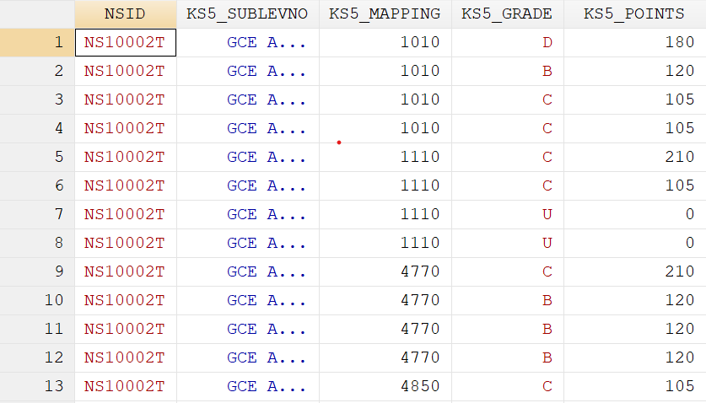
Understanding your data
An important step is to make sure variables are in their expected format.
Stata has a color-coded system for each type. Black is for numbers, red is for text or string and blue is for labelled variables.

Slide 5
First steps – Log files
Log files help you to keep a record of your work, and lets you extract output. When using extension *.log any word processor can open the file.

Slide 6
First steps – Do files
Do-files are ASCII files that contain of Stata commands to run specific procedures.
It is highly recommended to use do-files to store your commands so do you not have to type them again should you need to re-do your work.
You can use any word processor and save the file in ASCII format, or you can use Stata’s ‘do-file editor’ with the advantage that you can run the commands from there.
Either , in the command window type doedit or open the do file from the toolbar

Slide 7
First steps – Do files
You can write the commands, to run them select the line(s), and click on the last icon in the do-file window

Slide 8
First steps – Open your dataset
To open files already in Stata with extension *.dta, run Stata and you can either:
  Go to file->open in the menu, or
  Type use “c:\mydata\mydatafile.dta”
If your working directory is already set to c:\mydata, just type use mydatafile
To save a data file from Stata go to file – save as or just type: save, replace

Slide 9
First steps – How to find the right variables
You can use the command lookfor to find variables in a dataset, for example you want to see which variables refer to age, type:
  lookfor age
lookfor will look for the keyword ‘age’ in the variable name and labels. You will need to be creative with your keyword searches to find the variables you need.
It always recommended to use the codebook that comes with the dataset to have a better idea of where things are.

Slide 10
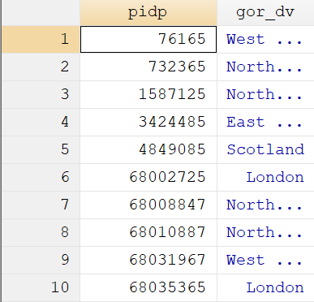
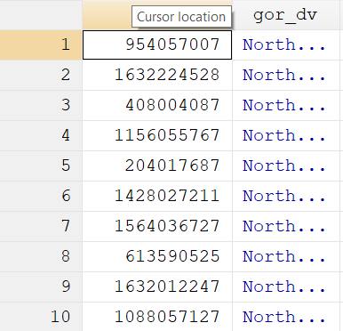
First steps – Sort and look at your dataset
Use “browse” to inspect your dataset
Use “sort” to sort the dataset the way you need or prefer
Sort pidp
Sort gor
br pidp gor

Slide 11
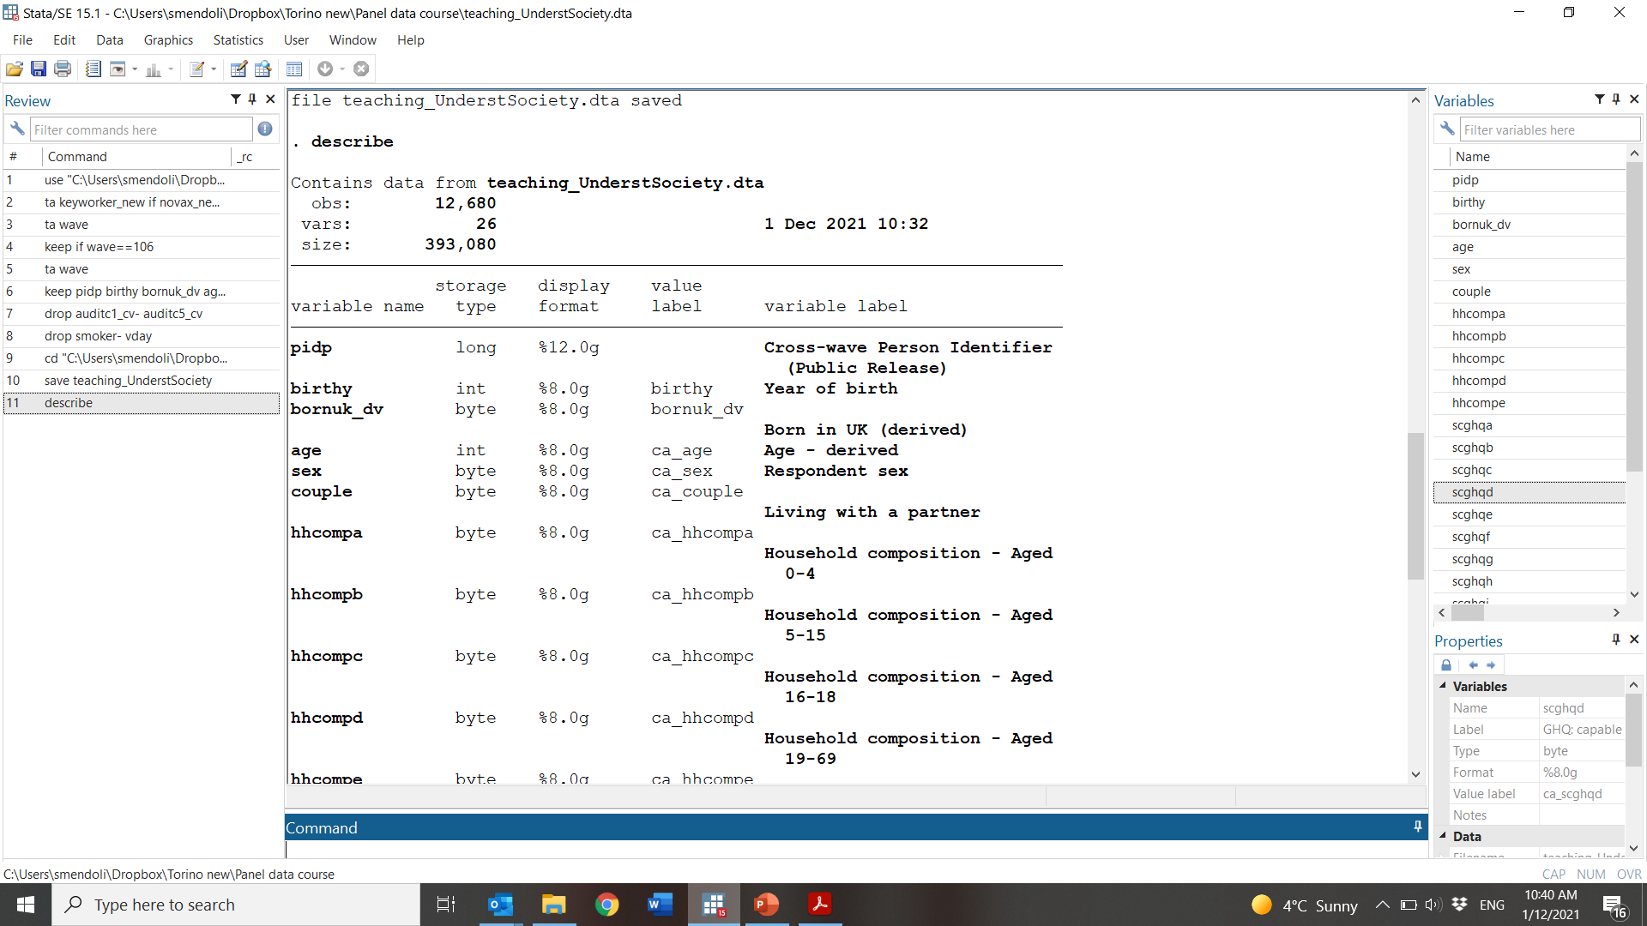
Describe data
Open your dataset
To get a general description of the dataset and the format for each variable type describe

Slide 12
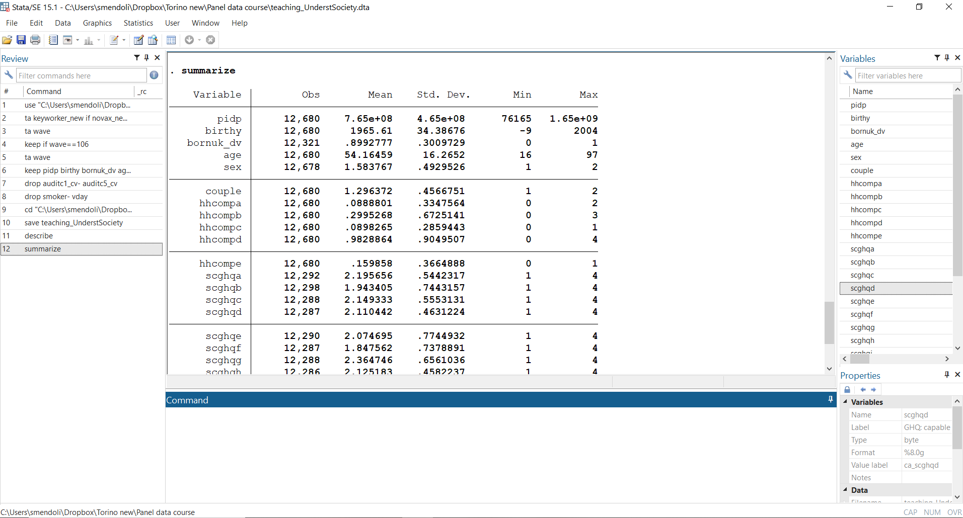
Summarize your data (1/3)
To get some basic statistics of the dataset type summarize

Slide 13
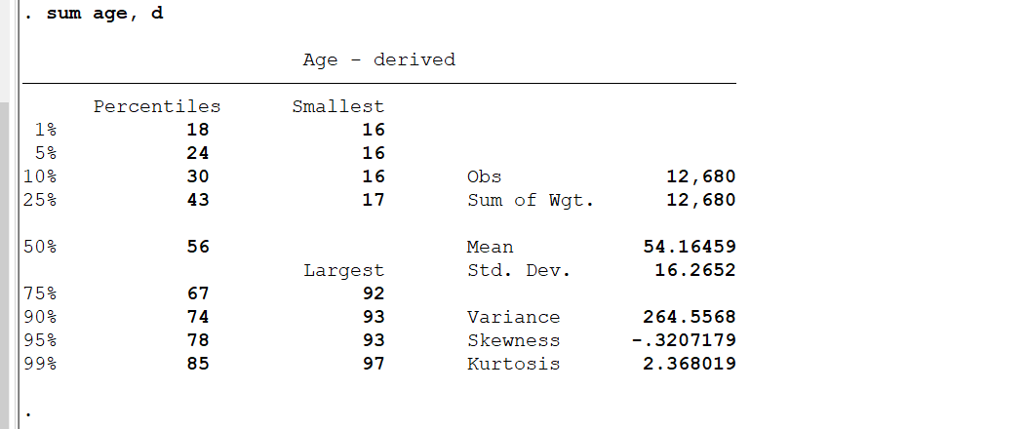
Summarize your data (2/3)
To get detailed stats of a variable, use summarize, detail

Slide 14
Summarize your data (3/3)
Percentiles
sum age, detail
return list /* See saved results*/
gen pctile90=r(p90) /* Generate a variable with the 90th percentile of age variable*/

Slide 15
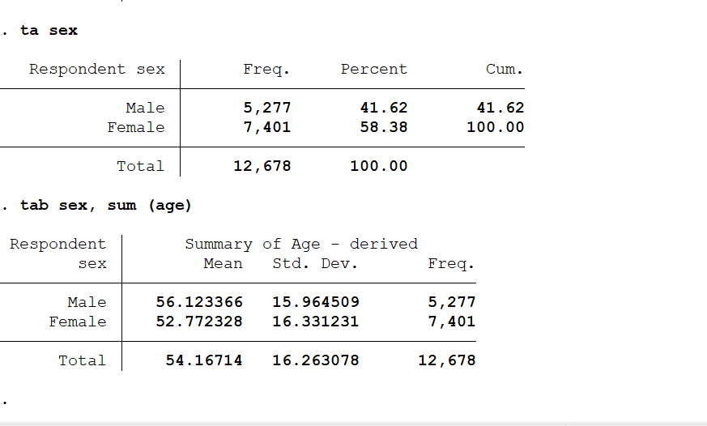
Explore your data: frequencies
tab
tab sex, sum (age)

Slide 16
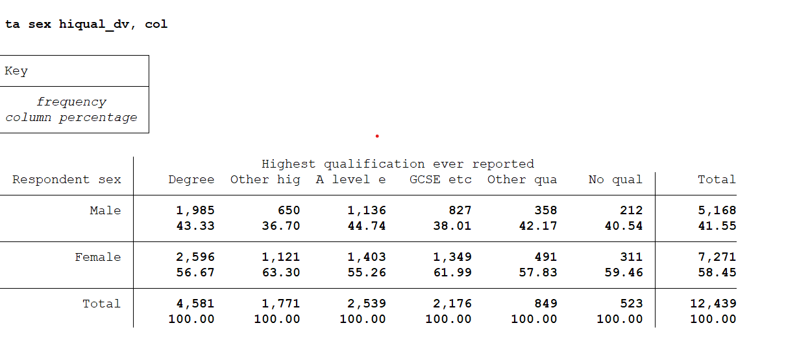
Explore your data: cross tabs
tab x y, col

Slide 17
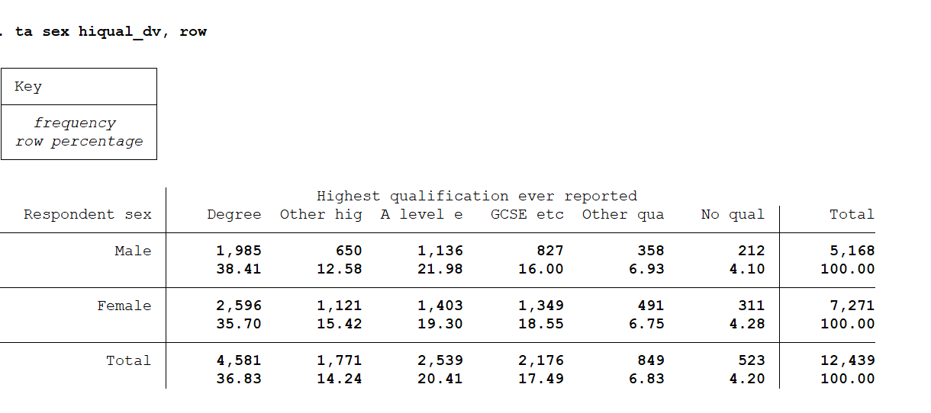
Explore your data: cross tabs
tab x y, row
Tab x y, col

Slide 18
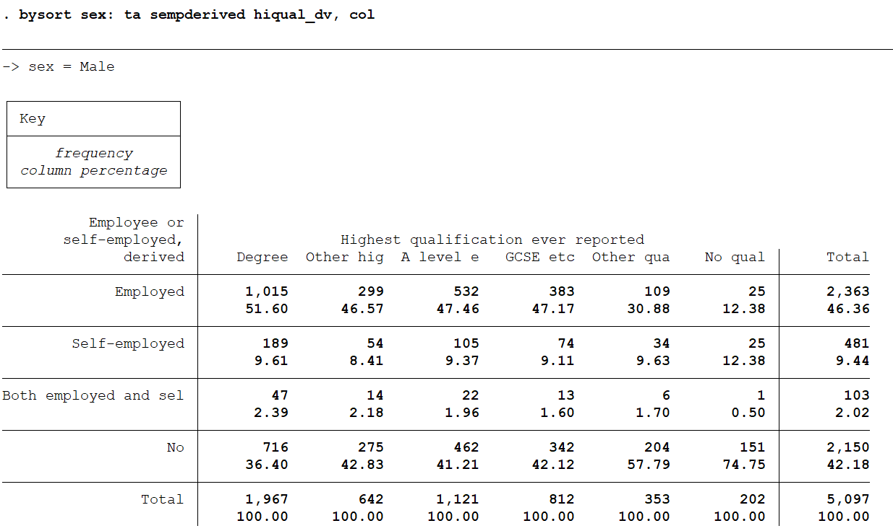
Explore your data: cross tabs
Three way cross tabs

Slide 19
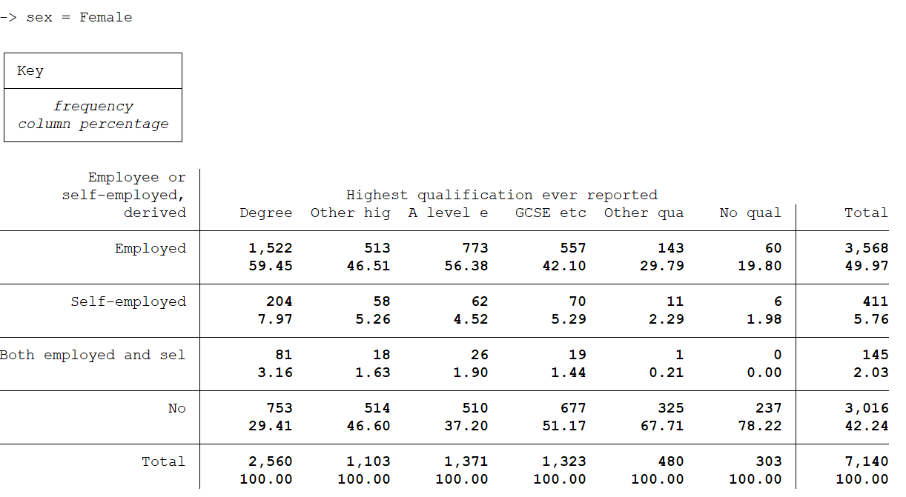
Explore your data: cross tabs
Three way cross tabs

Slide 20
Renaming and labelling variables
Rename

Slide 21
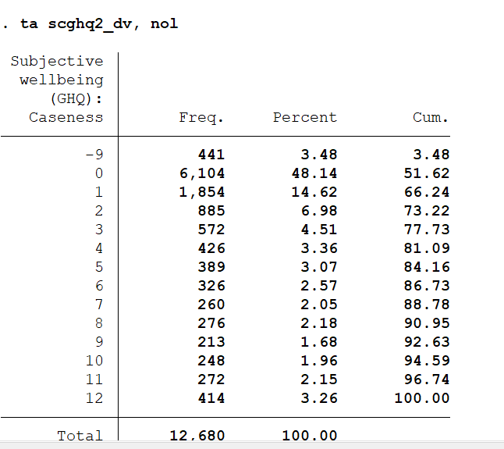
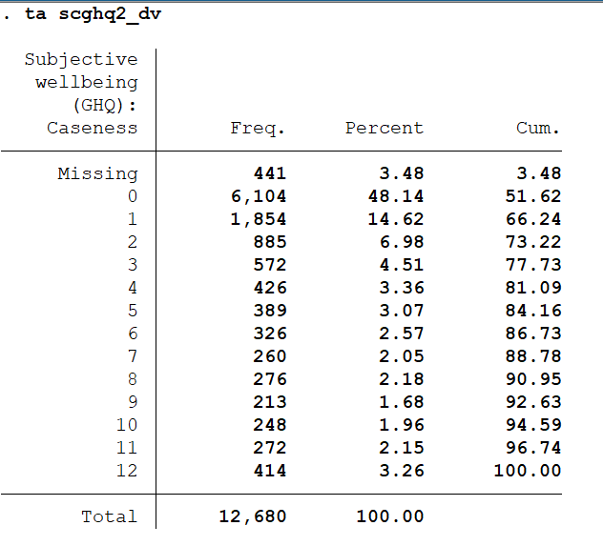
Missing values
In many datasets, missing values are coded with negative number
Remember to replace these values with missing
replace scghq2=. If sghq<0

Slide 22
Generate new variables
gen and replace
gen age_band=1 if age<=20
replace age_band=2 if age>20 & age<=30
replace age_band=3 if age>30 & age<=40
replace age_band=4 if age>40 & age<=50
replace age_band=5 if age>50 & age<=60
replace age_band=6 if age>60 & age<=70
replace age_band=7 if age>70 & age<=80
replace age_band=8 if age>80
replace age_band=. if age==.

Slide 23
Assigning labels to variables
Label values
Adding labels to each category in a variable is a two step process in Stata.
Step 1: You need to create the labels using label define, type:
label define label1 1 “less20” 2 “20-30” etc
Step 2: Assign that label to a variable with those categories using label values:
label values var1 label1
If another variable has the same corresponding categories you can use the same label, type
label values var2 label1
Verify by running frequencies for var1 and var2 (using tab)
If you type labelbook it will list all the labels in the datafile.

Slide 24
Assigning labels to variables
label define age_bands 1 "less20" 2 "20-30" 3 "30-40" 4 "40-50" 5 "50-60" 6 "60-70" 7 "70-80" 8 "more80"
label values age_band age_bands

Slide 25
Recoding variables
Recoding ‘age’ into three groups
Use recode command, type
recode age (18 19 = 1 “18 to 19”) ///
(20/29 = 2 “20 to 29”) ///
(30/39 = 3 “30 to 39”) (else=.), generate(agegroups) label(agegroups)
The new variable is called ‘agegroups’

Slide 26
Generate new variables
gen agesq=age^2
Use generate to create a constant variable
  generate x = 5
  generate y = 4*15
  generate z = y/x

Slide 27
Generate new variables
gen from a combination of other variables
  To see the values of the variable “sex”:
    tab sex, nolabel
  To create a binary variable for female:
    g female=(sex==2)
  To create a binary variable for women younger than 50:
    gen fem_less50=(sex==2 & age<50)
  Please be careful with missing values!

Slide 28
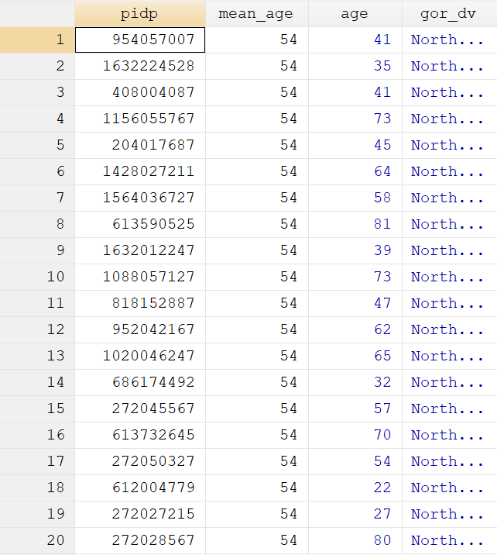
Generate new variables
egen is used to create a variable based on an expression and one or more other variables
Check the help: very useful command with many functions!
bysort gor_dv: egen mean_age=mean(age)

Slide 29
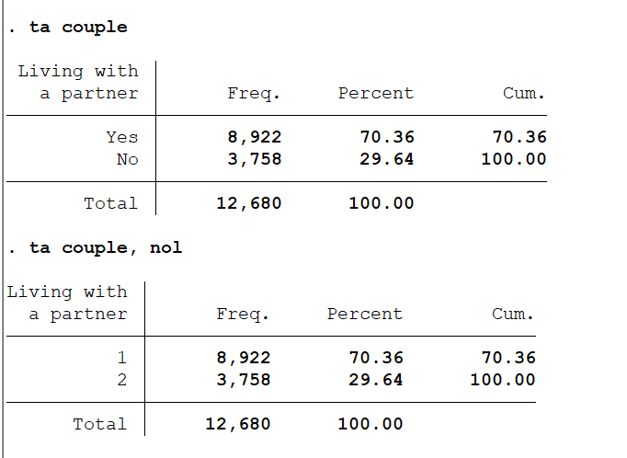
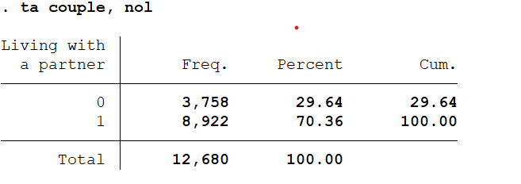
Changing variables values
Replace couple=0 if couple==2

Slide 30
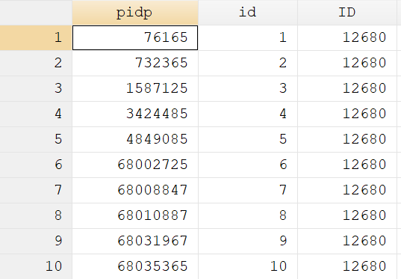
Creating indices
Using _n, you can create a unique identifier for each case in your data
gen id=_n
Using _N you can also create a variable with the total number of cases in your dataset
gen ID=_N

Slide 31
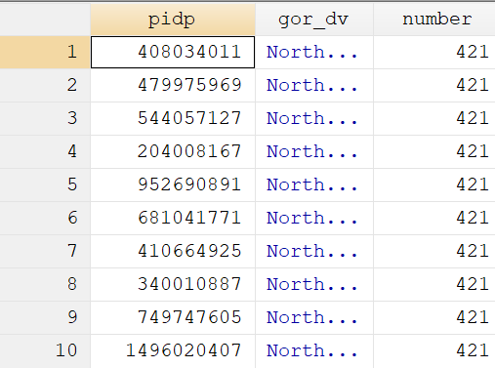
Creating indices by categories
Both _n and _N can be used to create indices by categories, using by and gen:
bysort sex: gen number=_N
Before using “by” we need to tell Stata to sort the data in the right way

Slide 32
Dropping and keeping variables
You can drop cases selectively using the conditional “if”, for example:
drop if female==1
Alternatively, you can keep individuals with specific characteristics
keep if age>=40

Slide 33
Graphs: histogram
Histograms are a good way to visually explore data, especially to check for a normal distribution. Type help histogram for details.
Histogram age, frequency
Histogram age, frequency normal

Slide 34
Graphs: means (1/2)
Stata can also help to visually present summaries of data.
If you do not want to type you can go to ‘graphics’ in the menu.
graph hbar , over(age_band)

Slide 35
Graphs: means (2/2)
graph bar, over(scghq2) by(sex)

Slide 36
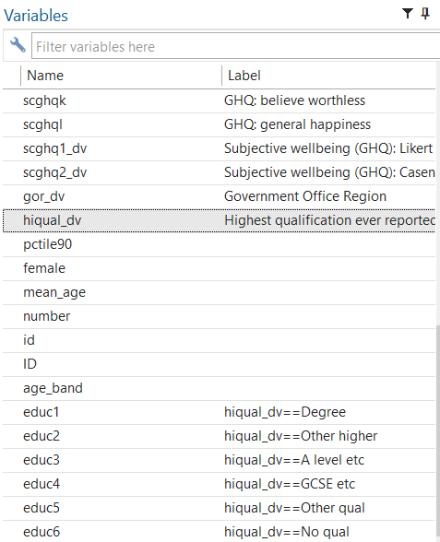
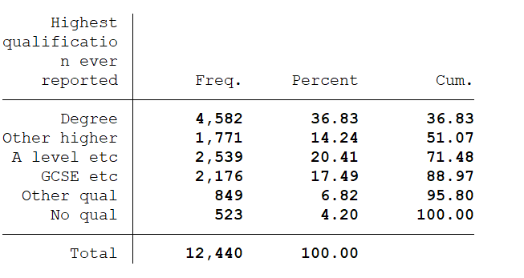
Creating dummy variables
You can create dummy variables by either using recode or using a combination of tab/gen commands
tab hiqual_dv, gen (educ)

Slide 37
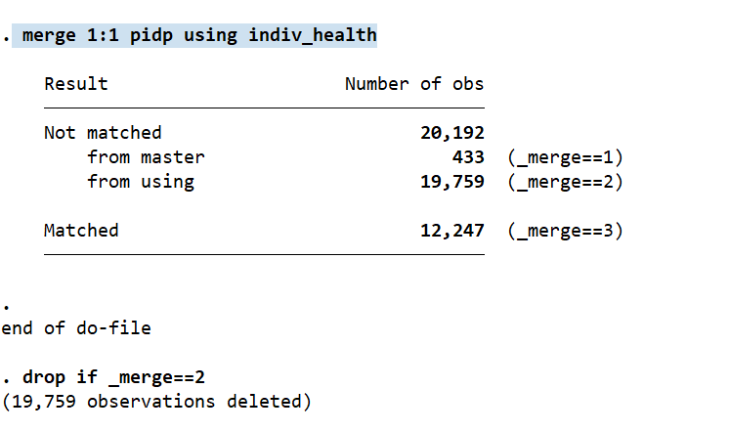
Merging datasets
You can merge two or more datasets using a common variables
sort pidp
merge 1:1 pidp using indiv_health

Slide 38
Merging datasets
The idea of merging is that we add some variables to the existing dataset (new columns)
We use merge when we have information in various datasets and we wamt everything in the same file
We can also append (new rows), when we have several waves to combine in one big longitudinal file

